Slide 1

App State: RMI Program and Brantley Risk and Insurance Center

Slide 2
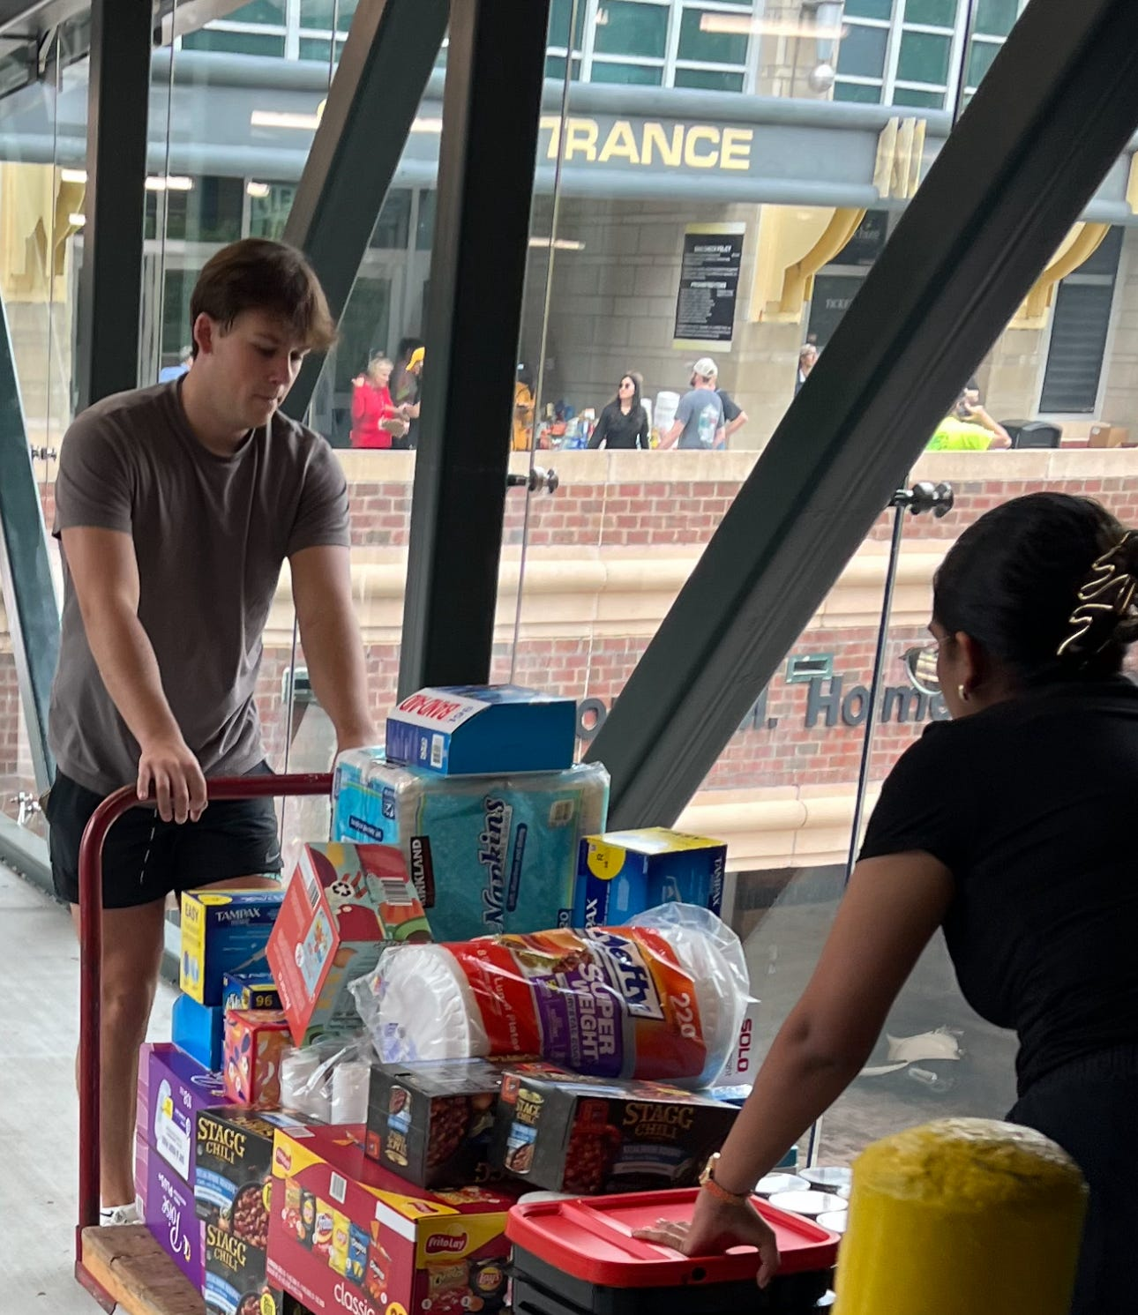
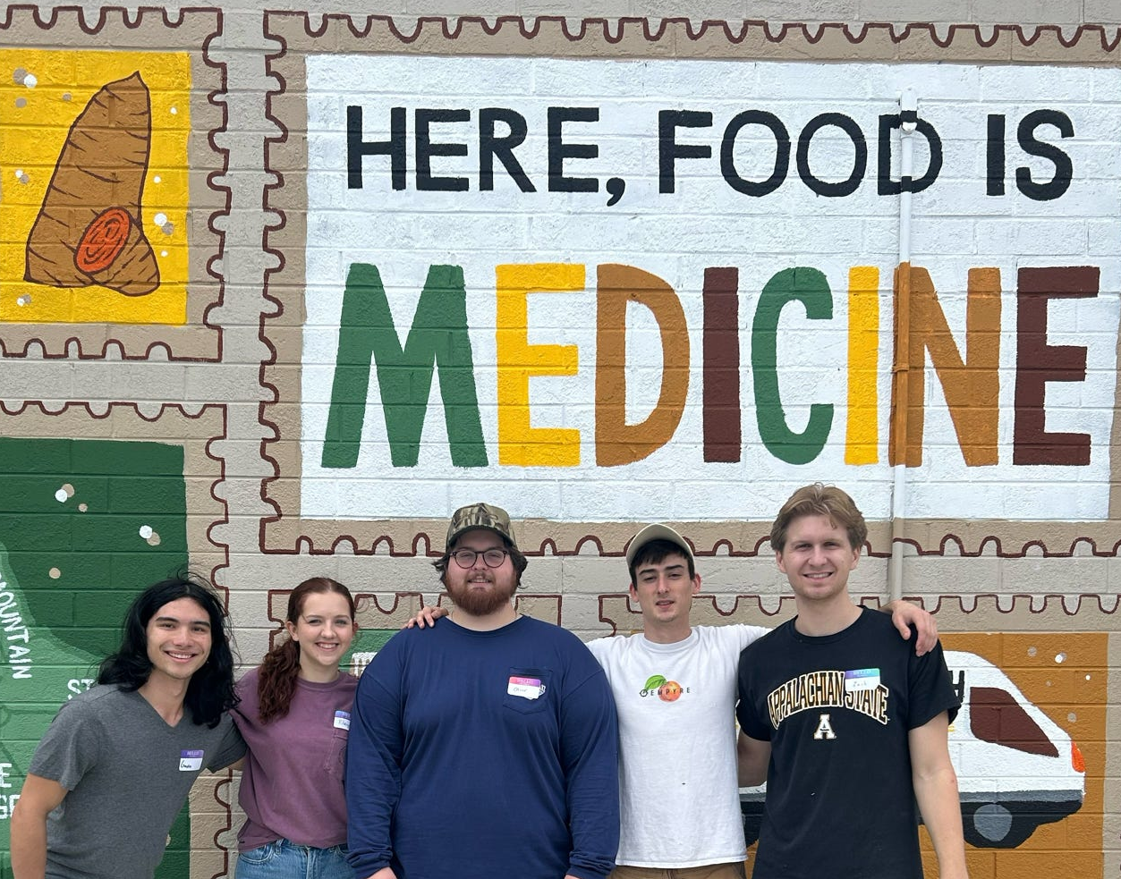
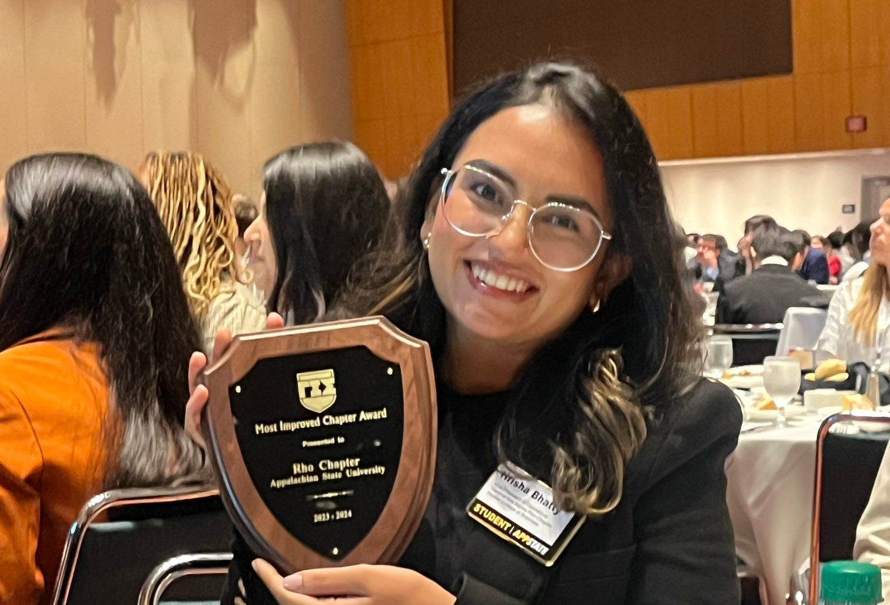
Risk Management and Insurance Program
141 Majors (15 Graduating Seniors in Dec)
24 Minors
May 2025 Graduates- 100% placement
7 Faculty Members, 2 staff members
Gamma Iota Sigma- Rho Chapter
15 student leaders
Community service focused
Notes:
.

Slide 3
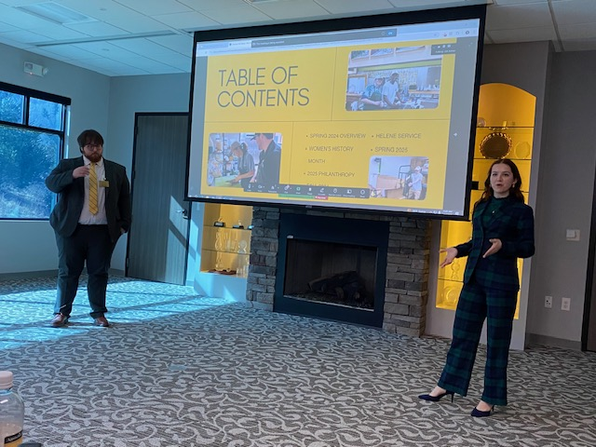
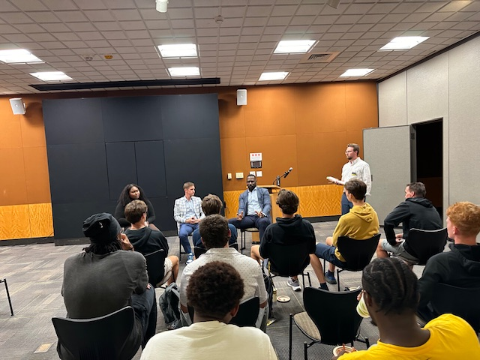
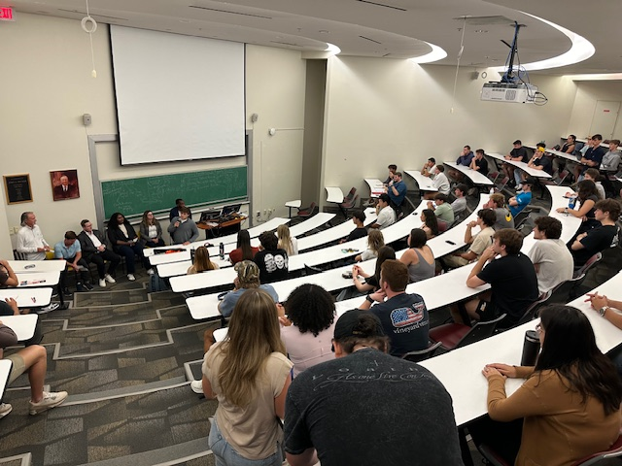
Brantley Risk and Insurance Center
Donor Funded, Specialized Center for RMI majors, minors, and others interested in insurance
Recruiting new students into the major
Management of scholarships
Physical space for students to study, socialize, and network
Creation and management of specialty events:
Dining Etiquette, local shadow days, GIS Open House Event, Student Athlete Insurance Panel

Slide 4
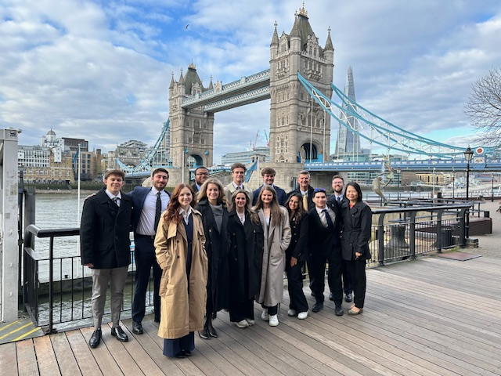
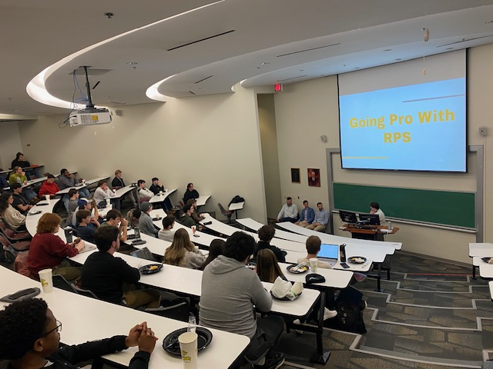
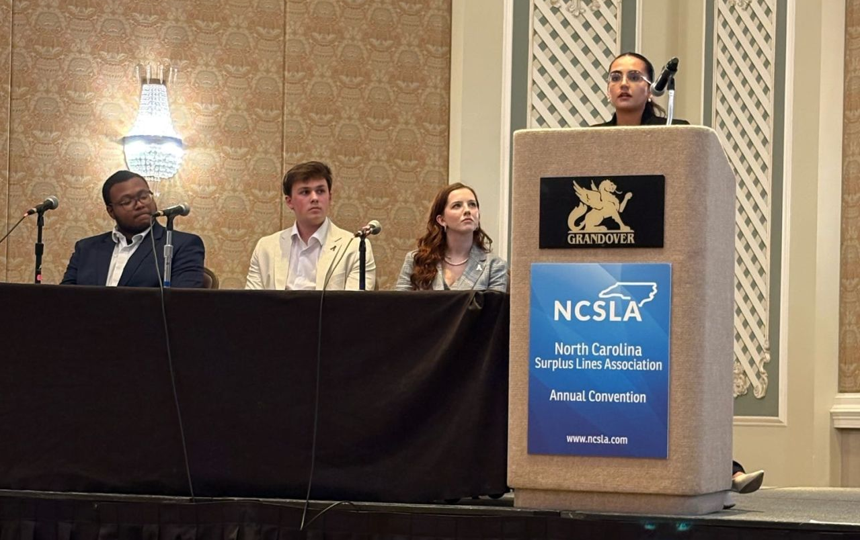
Events
Career Fairs
Walker Business Connection
Walker Spring Connect
Study Abroad
London (Spring Break)
Bermuda (Post-graduation)
Speaker Events
Markel, USI, Jackson Sumner & Associates, IMA, First Citizens Insurance
Travel
NCPRIMA, ISCEBS, RIMS Carolina, GIS Annual & Regional, IIANC InsurExpo, IIABSC, WSIA Extreme Risk Takers, NCSLA, Building Insurance Talent NYC Trip

Slide 5
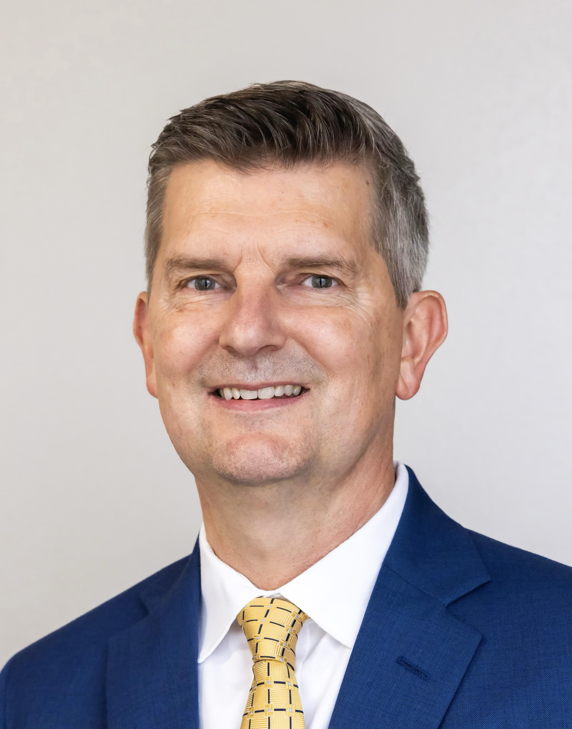
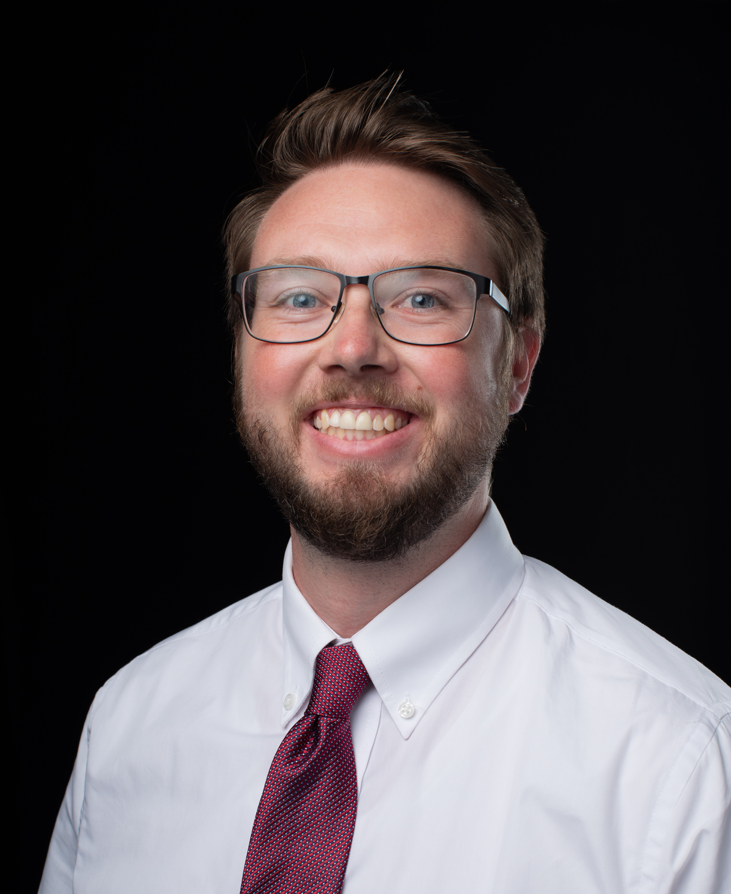
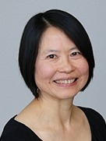
Contact Info
Dr. David Marlett
marlettdc@appstate.edu
Dillon Waschenbach
waschenbachd@appstate.edu
Wendy Deng
Dengwr@appstate.edu

