Slide 1




Slide 2

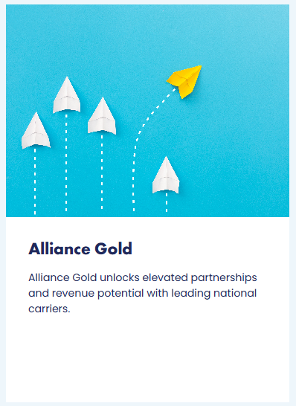
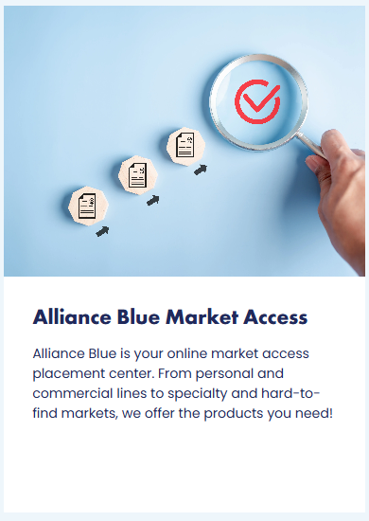
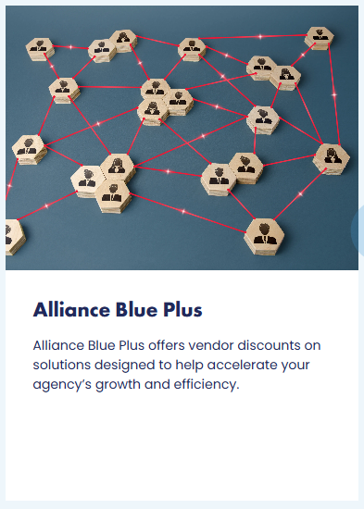
WELCOME TO THE ALLIANCE

Slide 3
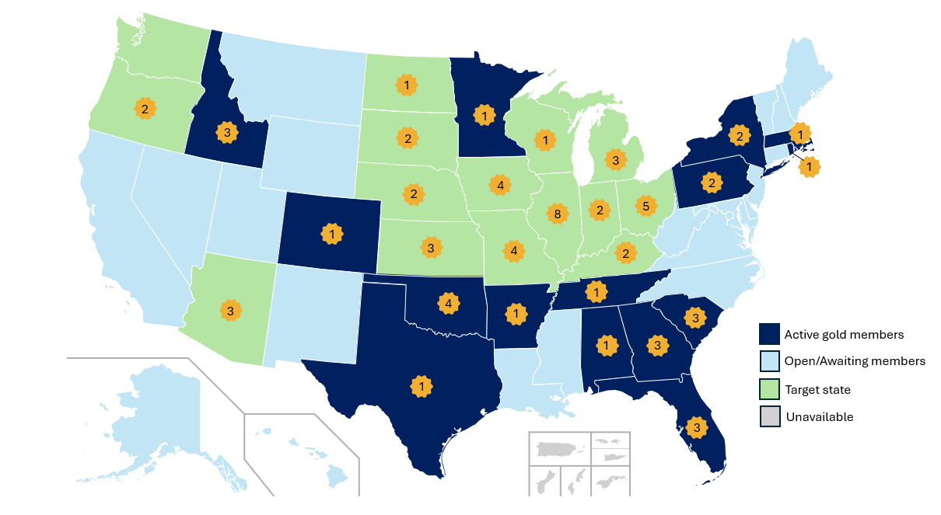
ALLIANCE GOLD
BY THE NUMBERS
72 Members
in 29 States

Slide 4
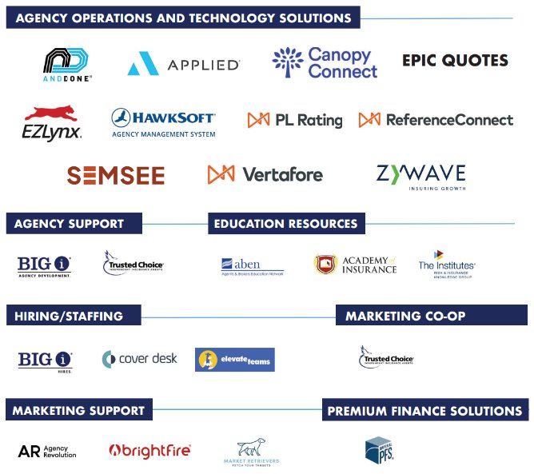

VENDOR PARTNERS
Notes:
Vendor Partners: 21 in 7 categories. Full range of agency development

Slide 5


PERSONAL LINES CARRIER PARTNERS
Notes:
Vendor Partners: 21 in 7 categories. Full range of agency development

Slide 6


COMMERCIAL LINES CARRIER PARTNERS
Notes:
Vendor Partners: 21 in 7 categories. Full range of agency development

Slide 7
Benefit to Joining Gold
Direct access to carrier systems and underwriters
Agency earns 100% commission, paid directly to the agency
Agency ownership of codes and expirations
Profit-sharing and incentive eligibility
National and Regional Carrier Partnerships
Optional Participation in a Master Agency E&O Program
Vendor Partnerships
To learn more, visit: INDEPENDENTAGENT.COM/GOLD

Slide 8
ALLIANCE GOLD PLACEMENT CENTER
Benefits of Blue to Alliance Gold Members:
Priority service – jump to front of line
Increased commission for aligned PL carriers
Assigned account executives
CLUE/MVR Reports at time of submission
Grow book of business to earn direct appointments with desired carriers. Carrier retains the right to appoint.
Notes:
Priority Service – Jump to front of line

Slide 9

GOLD MEMBER TESTIMONIAL

Slide 10
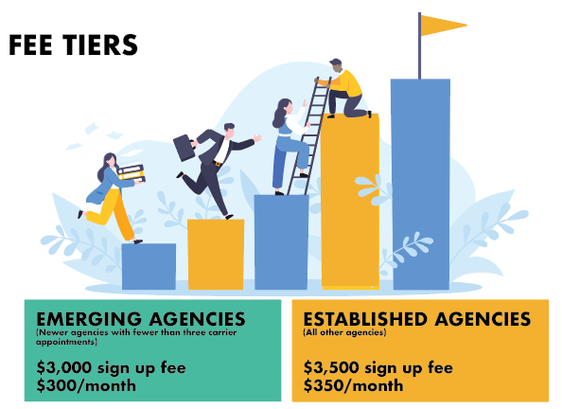
IDEAL FOR START-UPS

Slide 11

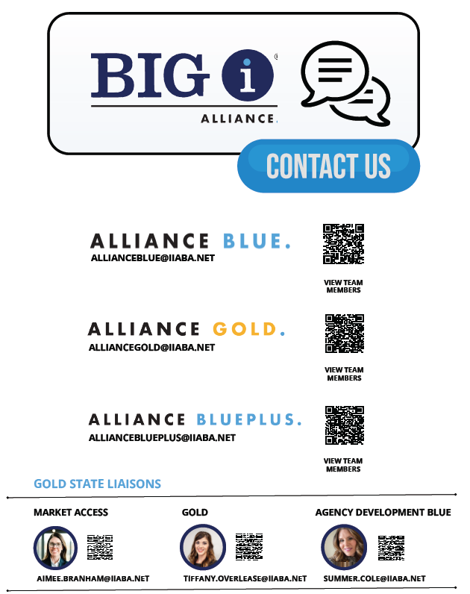

REACH OUT

Slide 12

Q&A
BIGIMEMBERALLIANCE.COM

