Slide 1
Change is Mandatory…Stress is Optional
What the most influential do differently

Slide 2
Curing Disengagement: Latest from Gallup
1 in 100

Slide 3
Engaged employees, clients and coworkers are…
40x
more likely to support you and your decisions, take ownership and resolve problems quickly
74%
less likely to mentally & emotionally checkout (improves commitment & awareness)
15.5x
more likely to stay with you (improves teamwork, and employee and client retention)

Slide 4
Engaged employees, clients and coworkers are…
9x
more likely enjoy working together & more likely look-out for each-other
43%
Safer on the job (fewer incidents, more focused and less complacency)
86%
more likely to be loyal to you, your offer, the job, the product and the culture

Slide 5
Validation = Engagement = Influence
Making people feel valuable and focusing much more on strengths than weaknesses, allows everything else you do to get better results!

Slide 6
Engagement Creates
Clarity and Loyalty

Slide 7

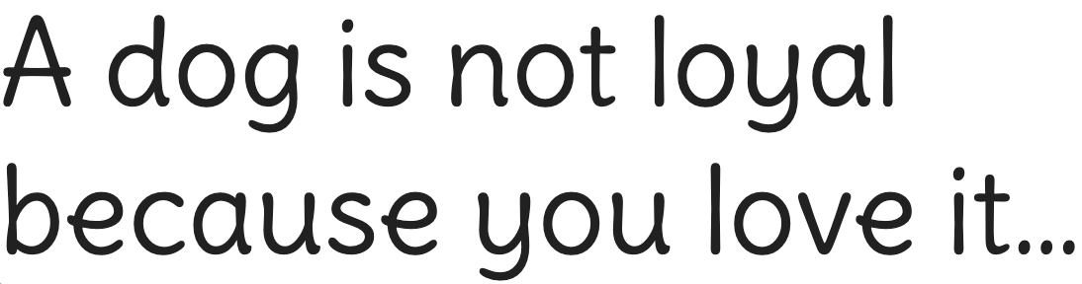
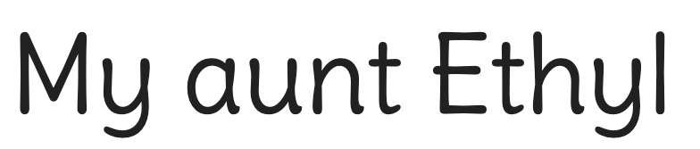
CLARITY
What does a good job look like when it’s finished? Not just the steps to get there
Does everyone know what's expected of them to create success?
Do you know what you‘re clients and employees value most?
Are we asking the questions that make this kind of clarity happen?

Slide 8
The best question for creating clarity and loyalty
“
Is there a question I didn’t ask you that you believe I should have?
”
It proves you listened; it proves you care; and it may get them to ask the question they were afraid to ask.

Slide 9
Offer understanding and guidance, not just expertise:
Let people know that you value their experience.
People need to see what they already know matters.
People get loyal when shown how
their OWN knowledge and abilities help them succeed.
Helping people to develop their own brilliance is much more effective than just giving them yours!

Slide 10
Generational Success : Acceptance = Influence
Of unemployed people in the U.S. age 22-32 years old are not looking for a full-time job/52% (Gallup, Pew Research & Apa.org)
38%
45%
Of this age group are having their lifestyles funded right now by their parents. They may be hard to recruit and quick to quit!
42%
₌
Of this age group said they do not believe in statistics at all
Gen Z and Y being funded right now and not hot for a job
A need for better tactics of influence and an understanding of who they are
Making Work Worth It
People quit people, not just the job. To attract a modern workforce, focus on the things you can do something about. What flies…

Slide 11
Generational Success: Acceptance = Influence
How people quit has changed (Bob vs Brandon/Mary vs Maddy)
Bulldozer parenting created a lack of resilience, and increased sensitivity
Solutions
Influence 18-30
Why, end-result, urgency level, I have faith in you
Not all young people are the same: Dylan GPS /4 kids
Worst leadership/influence strategy: Wishing people were like you
We must deal with people for who they are… not who we wish they were!

Slide 12
Respect and Culture: Things have changed
It’s the end of jerk-ism!
Being a jerk, no longer works
So, it takes a basic level of like-ability to have any positive influence these days
You don’t have to like me you just have to respect me!
No…these days no-one respects people they don’t like
People can’t give what they were never exposed to. Treat people the way you want them to treat others!
It’s how you create a culture of change that sticks

Slide 13
The Reality of Success: Getting Real About People
We are our age: 20’s to 30’s, 40 to 50’s, 60’s over 75 (age affects reactions)
Under 35 Kindergarten/partner vs compete/I’m old enough
The greatest impact on any generation is the one before it
Frontal cortex (decision making/impulse control) not fully developed until age 26
A sense of belonging & participation can override impulse: Inclusion = Success
Change is a non-negotiable, so we have to drive that message strongly
Being too harsh can backfire I told my GF she needed to embrace her mistakes
Sometimes we forget the basics and then wonder why the specifics don't work!

Slide 14
Simple = Buy-in
6 PEOPLE LAST YEAR HOSPITALIZED for biting McDonalds Hot-Apple pies (simple wins)
If you can’t simplify something, people think you don’t understand it well-enough yourself…simple is the new smart: No-one buys into an idea they don’t understand! “You can’t scale complicated”

Slide 15
Ownership, Celebration and Wisdom Create Change
Give people the steering wheel and the GPS… people won't own results if they think someone else is driving. Ownership = Change
Celebrate the small wins. The State Superintendent of Education in Mississippi said his goal is to be 49th
Celebrate progress not just perfection. Recognition builds pride. We can’t wait for the planet's to perfectly align before we take action
Perfection is the foundation of procrastination.
Change isn’t punishment… it’s proof we’re doing something right. We’re scaling up and will gain our own wisdom through experience.
True wisdom is reached when you've made every mistake you could possibly make and there's nothing left to do but succeed!

Slide 16
Communicating Through Conflict: Transparency s
Listen like you mean it: Not just “waiting for your turn to talk”
You showed up with the answer and you're just waiting for the pause!
Savoring small agreements is better than a big staring contest.
Transparency can’t eliminate disagreement; it just makes it productive
Disagreement is the foundation of true agreement
Disagreement sparks dialogue, and dialogue builds trust (if we let it)
Recently learning how the Ancient Romans made self sealing concrete should teach us that not sharing ideas can really delay progress
We can all agree that people who think they know everything really upset those of us who do!

Slide 17
Psychological Safety
Older people may not be willing to speak up because they were taught to tough-it-out; or fear being viewed as unadaptable. Younger people think speaking up means they are being annoying. So, they hesitate to ask questions or provide important information.
Just because angry Bob was fired in a meeting in 1997 (he threw a chair) does not mean you cannot say what you think now!
“It takes more guts to asked for help than it does to say you don’t need any help, and please annoy me before you stop caring!” Success is a team sport

Slide 18

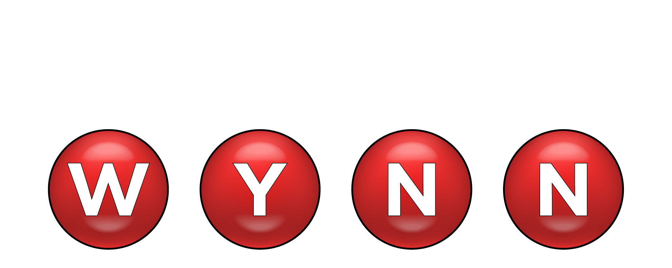
The caveman that went to fight the sabretooth tiger by himself is not our ancestor?
The caveman that said, “Hey we need some more people and a better plan!” We are the direct descendants of those people

Slide 19
The Real Truth about Stress
Stress is not a thing, it’s a belief that makes us worry/Hospitals & airplanes
Expect bad news (war, economy, politics, scary new tech and pandemics)
Focusing on problems we can’t solve creates stress: Social media distracts us
Focusing on problems we can solve reduces stress (accomplishment = less stress)
Stressed-out = micro-management = lack of trust = lack of focus = burnout
Doing what's important reduces stress: Focusing on the right things = Success
The leading cause of stress is knowing exactly what you're supposed to be doing and consistently doing something else!

Slide 20
You Can’t Lead by Example (if you are a bad example)
The definition of leadership is someone following someone…
You can't get buy-in from people unless you have “bought-in” yourself
The believers are the achievers: They have the most influence
Creating accountability that sticks: Right way/wrong way
Backrub: You don’t have to right to be successful
Talking change to WW2 Vets in 1980s/honoring experience and using it
Change is not the issue; it’s resistance to change: My dad
Action and Adaptability Create Opportunity

Slide 21
Your Influence in Action
If you are willing to take at look at the role you play in other people's behavior, you have massive influence.
What flies out of your mouth is the culture
Knowing it and doing it have nothing in common: Knowledge /Heroes and…
There is guy driving down the free way and cars are everywhere!

Slide 22
Are we (personally) influential enough to get people to change and embrace the changes that will make us more effective?
Change
Circumstances do not create your destiny… YOU DO! Someone always succeeds in times of change WHY WOULD THAT NOT BE YOU?
is the foundation of Civilization!
Leadership, influence, trust, communication, accountability
are the foundations of change
Position yourself to win first and then put your efforts behind that.
Set yourself up for success by creating an advantage before a problem happens

Slide 23






Join us Online
facebook.com/GarrisonWynn
linkedin.com/in/garrisonwynn
keynotespeakergarrisonwyn
garrisonwynn
garrisonwynn
garrisonwynn.com

