Slide 1
Big “I”
Federal Government
Affairs Update
Nathan Riedel
Big “I” SVP, Federal Gov’t Affairs

Slide 2
Update on Government Funding
A partial federal government shutdown began on October 1 after Congress failed to agree on a new FY2026 funding deal.
Roughly 750,000 federal employees have been placed on furlough. “Essential employees,” including active-duty military members, will be required to work despite not getting paid.
The House has passed a continuing resolution to keep the government open through November 21, giving Congress more time to complete 12 spending bills.
NFIP: FEMA still has authority to ensure payment of valid claims with the funds it has on hand. Existing policies are allowed to remain in effect until they expire.

Slide 3
Tax Reform
Congress passed (along party-lines) and the President signed into law the OBBB (now the “Working Families Tax Cut Act”) in July.
Throughout the process, Republicans had to navigate a razor thin margin to pass this major tax legislation. Fiscally-minded legislators were constantly looking for “pay-fors” to offset new spending.
  Eliminate tax-exempt status of 501(c) organizations?
  Increase the top marginal tax rate or create a millionaire tax?
  Modify the 199A 20% deduction?
  Make changes to the corporate rate?
  Change the employer health benefits tax exclusion (estimated $300 billion cost annually?

Slide 4
Big Win for Big “I” Agencies
  No changes to the U.S. corporate rate of 21%.
  Individual rates remain in place with a top tax bracket of 37% while modifying the inflation adjustment for various tax brackets.
  The 20% deduction (Section 199A) for pass-throughs made permanent.
    In 2018 the Big “I” worked to make sure IAs were not considered “specified services” and therefore able to take full advantage of this provision.
  According to the 2024 AUS, 86% of Big “I” members are organized as pass-through entities.

Slide 5
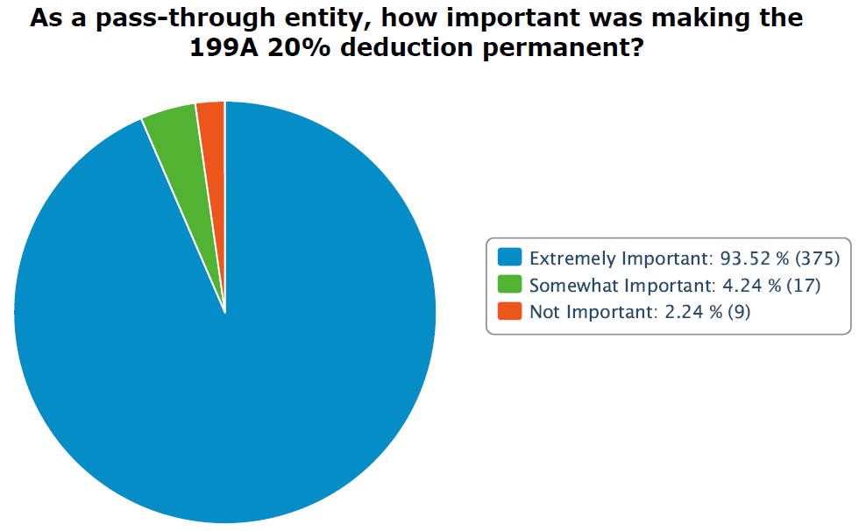
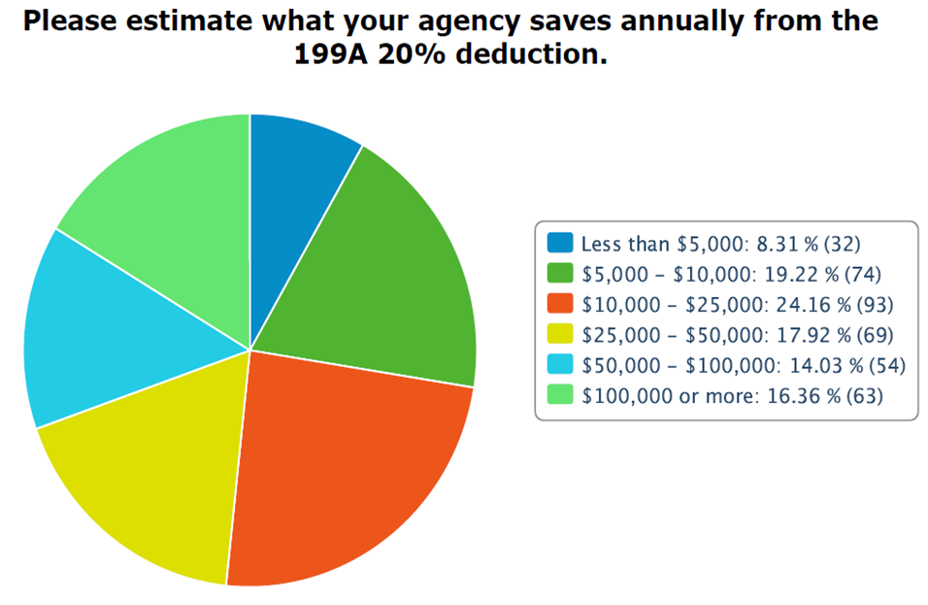
Yearly Savings According to Survey
Data collected from a survey of 402 pass through agencies in September 2025.

Slide 6
Big Win for Big “I” Associations
  The House tax package originally included language to subject tax-exempt organizations’ royalty income to the unrelated business income tax (UBIT) – 21%.
  The Big “I” led the coalition efforts on this issue and successfully worked with the Ways & Means Committee Chair and House Republican leadership to remove that entire section of the bill.
  According to the 2023 990 disclosures and information states provided, subjecting royalty income to UBIT would have cost Big “I” state associations approximately $2 million annually.
  This advocacy saved Big I South Carolina $42,000 annually.

Slide 7
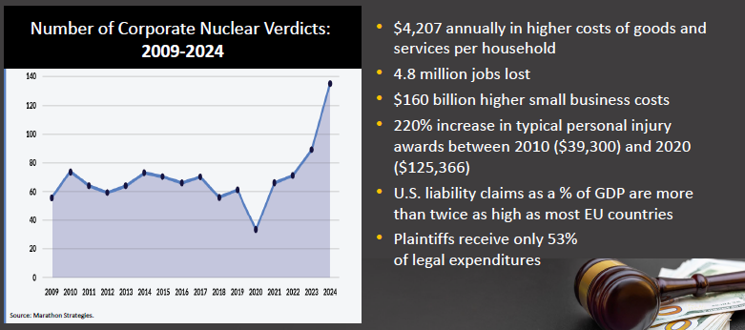

Slide 8

Verdicts are Skyrocketing
Verdicts in liability lawsuits have skyrocketed and are especially notable in product liability and commercial auto, rising 7.1% annually between 2016 and 2022.
Policyholders should be made whole when appropriate, but the plaintiff’s bar is exploiting the judicial system for financial benefit. That abuse leads to higher insurance costs for all consumers.
1994 | 2025
Liebeck v. McDonald’s: | Garcia v. Starbucks
$160,000 Compensatory Damages and $2.7M in Punitive Damages (reduced to $480,000 by the judge) | $50 million in compensatory and punitive damages.

Slide 9
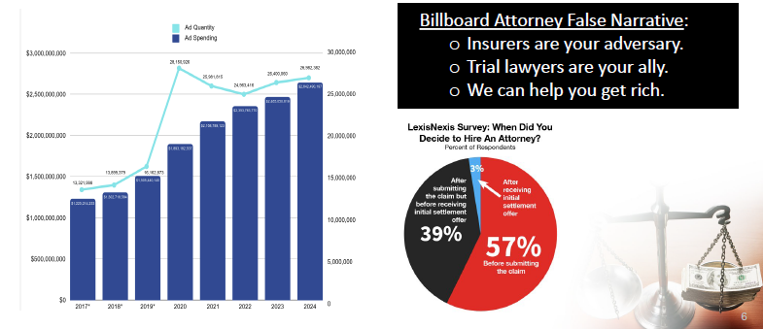
Lawyer Advertising Attacking Insurers

Slide 10
Third Party Litigation Funding
Third Party Litigation Funding (TPLF): when an outside agent – someone not involved in a legal dispute – pays a plaintiff’s legal fees with the expectation of financially profiting off any settlement or judgment.
It is a growing multibillion-dollar industry with sophisticated investors threatening the integrity of the U.S. Court System with many avoiding any U.S. tax obligation.
An estimated $15.2 billion in assets were allocated to U.S. commercial litigation investments in 2023, and a separate analysis predicts that commercial litigation funding could reach $31 billion in the U.S. by 2028.
Sophisticated investors treat our court system like a casino.

Slide 11
TPLF / Legal System Abuse
Came close in the Senate tax bill, which at one point included a Big “I”-supported provision to tax TPLF proceeds at a 40.8% rate.
Litigation finance firms and plaintiffs’ bar launched aggressive campaign, and the Senate Parliamentarian ultimately stripped the provision.
The Litigation Transparency Act requires disclosure of TPLF agreements and payments in civil lawsuits.
The Tackling Predatory Litigation Funding (TPLF) Act would close the TPLF tax loophole.
Protecting our Courts from Foreign Manipulation Act would increase transparency and prohibit foreign states & sovereign wealth funds.

Slide 12
Other Federal Issues
Reauthorize the National Flood Insurance Program (NFIP).
The Big "I" supports pre-disaster mitigation efforts, including the Fix Our Forests Act, the Disaster Resiliency and Coverage Act of 2025, and the Disaster Mitigation and Tax Parity Act of 2025.
The Big "I" supports legislation to eliminate the Federal Insurance Office (FIO), which has shown questionable value to consumers.
Data privacy legislation is being considered in the U.S. House.
The Terrorism Risk Insurance Act (TRIA) is currently scheduled to expire on December 31, 2027.

Slide 13
Insurance Campaign Institute
Placing more insurance professionals in elected office is critical to shape public opinion and to enact good policy.
Objective: recruit, train and equip insurance professionals with the knowledge to run and win campaigns for elected office.
Candidates will come from the insurance industry (agents, brokers, underwriters, CSRs, company personnel, spouses & family, etc.), have a strong business orientation, regardless of party affiliation, and desire to run for elected office.
The program is open to individuals seeking office at any level of government – local, state, or federal.

Slide 14
Campaign Institute Cont.
The Institute is essentially a boot camp training program conducted over one full day, is comprehensive and covers the following topics:
  Campaign organization, fundraising, polling, grassroots mobilization;
  Social media, messaging and advertising; and
  How to put the insurance community to work for you.
It will be funded with sponsorship money, and the only cost to participants will be transportation to/from DC.
The Institute will be conducted yearly with the inaugural program on April 20-21, 2026, immediately before the Big “I” Legislative Conference.

Slide 15
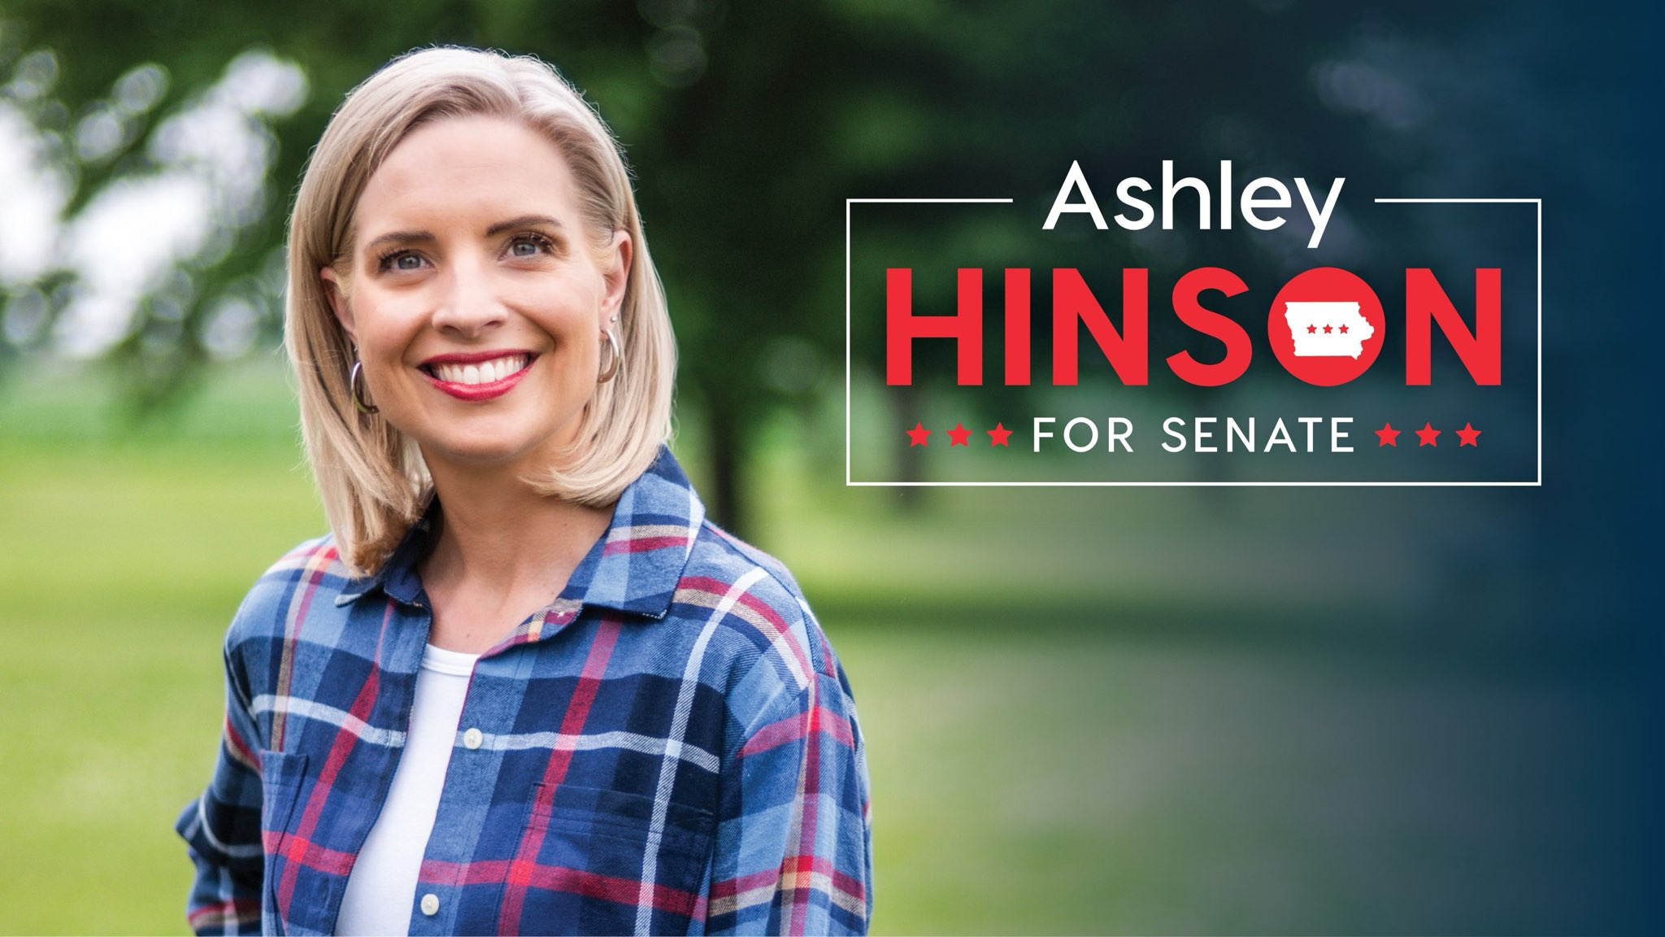
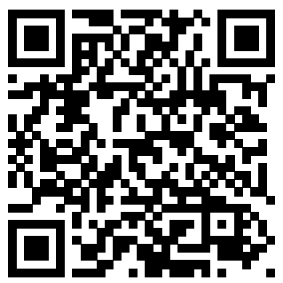
Big "I" in Congress
U.S. Rep. Ashley Hinson (IA-02) running for U.S. Senate
Ashley has largely cleared the primary field and received endorsements from the President, Senate Leadership and many prominent officials in the state.
If we can get her across the finish line, she will immediately become one of the most knowledgeable Senators on insurance issues.
We want to show Ashley how much support she has from the independent agent community, and we have already begun fundraising on her behalf. We hope you’ll consider joining us with a contribution of any amount:
https://secure.anedot.com/ashley-for-iowa/bigi

Slide 16
InsurPac in South Carolina
InsurPac is one of the largest and most recognized PACs on Capitol Hill.
In 2024, South Carolina ranked 1st in total raised, most raised from Young Agents, and in $$/agency
 | InsurPac $$ | $$ Per Agency | # Donors
2023 | $126,865.00 | $417.32 | 254
2024 | $117,913.00 | $406.60 | 211
2025 YTD | $39,805.00 | $133.57 | 110

Slide 17
2024 InsurPac Major Donors
Millennium Club ($5,000):
Platinum Club ($2,500-$4,999):
Centennial Club ($1000-$2499):
Gus Brabham | Bret Carter | Jon Jensen | Robbie Nalley | Tonya Thomason
Ashley Brady | Zander Galloway | Ben Myers | Jay Taylor
Jules Anderson | Tom Bates | John Dawson | Matt Hamer | Lindsay Hartfield | Shane Lynn | Jimmy Rowe
Will Bowers | Peter Burrous | Lee Ellis | Ben Galloway | Danielle Lambert | Jen Myers | Julie Turner
Rebecca Brady | Derrik Chandler | John Foreman | Melody Herring | Ryan Moniz | Frank Sheppard | Matt Wiseman
Tim Briles | Dow Colet | Bill Fuge | Lauren Huffman | Bob Mosely | Paul Steadman | Garrett Wreden
Curtis Bull | Russ Dubinsky | Chad Gabrielson | Fran Johnson | Melinda Mosely | Drew Theodore

Slide 18
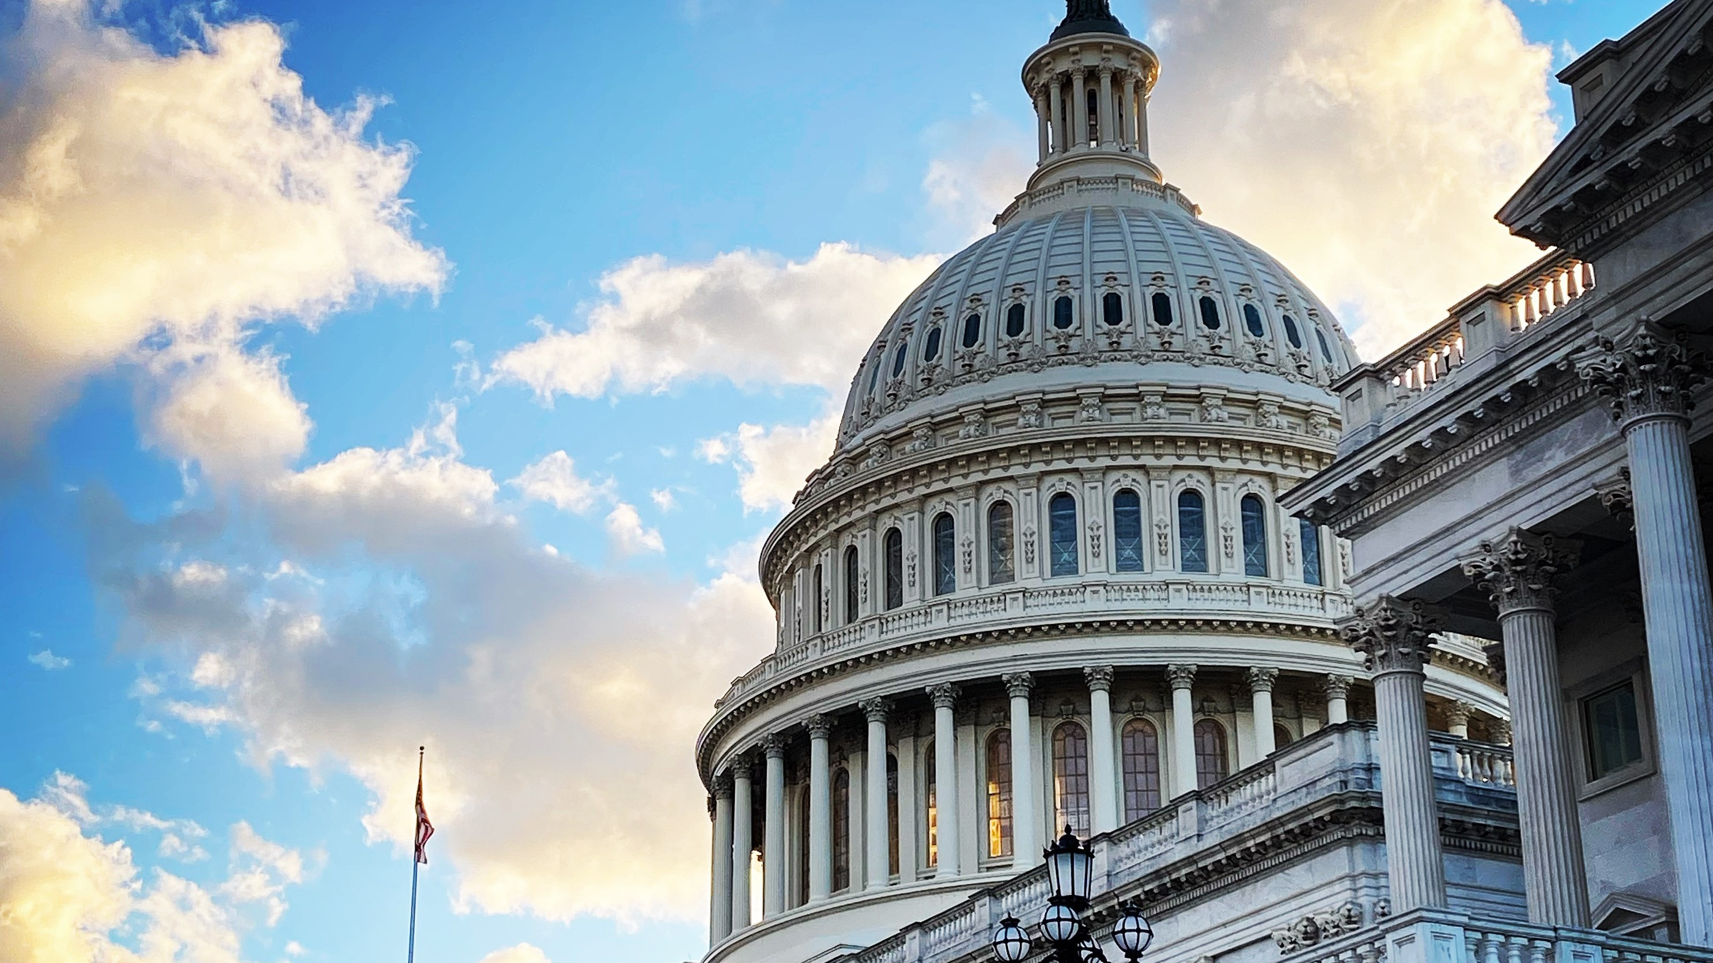
INDIANA INFORMATION
Big “I” Legislative Conference
April 22 – 24, 2026

