Slide 1
Key Business Income Concepts
Christopher J. Boggs, CPCU, ARM, ALCM, LPCS, AAI, APA, CWCA, CRIS, AINS
Sr. Product Manager
March 21, 2024

Slide 2
Business Income
Net Income (Net Profit or Loss before income taxes) that would have been earned or incurred; and
Continuing normal operating expenses incurred, including payroll
From ISO’s definition of Business Income found in the CP 00 30 and CP 00 32

Slide 3
Net Income
Business Income Form:
Defined as: “Net Income (Net profit (or loss) before income taxes)”
AKA: EBT = Earnings Before Taxes (Pre-Tax Earnings or Pre-Tax Profit)
When the risk is classified as a manufacturing operation, Net Income includes the sales value of production per CP 00 30 and CP 00 32
VS.
Accounting/Finance:
Revenue - Expenses = Net Income
Net income is the total income from revenue (sales and other income) after all business expenses (operating expenses, cost of goods sold (COGS), depreciation, interest, and taxes) are deducted.
Net Profit: Taxes are subtracted

Slide 4
Continuing Normal Operating Expenses
Normal operating expenditures that continue (in whole or in part) during the time the operations are discontinued (“period of restoration”) due to a direct property loss.
Includes payroll, unless reduced or altered by the CP 15 10 endorsement as per the Business Income Report/Worksheet (CP 15 15)

Slide 5
“Period of Restoration”
"Period of restoration" means the period of time that:
  a. Begins: (1) 72 hours after the time of direct physical loss or damage for Business Income Coverage;
Ends on the earlier of:
  the date the property should be repaired, rebuilt or replaced with reasonable speed and similar quality; or
  the date when business is resumed at a new permanent location.
From ISO’s definition of “Period of Restoration” found in the CP 00 30 and CP 00 32

Slide 6
2 “Period of Restoration” Triggers
The "suspension" must be caused by direct physical loss of or damage to property at premises which are described in the Declarations….
The loss or damage must be caused by or result from a Covered Cause of Loss.
From ISO’s Business Income Insuring Agreement found in the CP 00 30 and CP 00 32

Slide 7
Factors That May Affect the “Period of Restoration”
Time to adjust the direct property loss;
Development of building plans;
Finding a contractor;
Building permits;
Site preparation including clearing the site of damaged or destroyed property;

Slide 8
Factors That May Affect “Period of Restoration”
Time to rebuild;
Time to restock;
Rehiring/hiring employees;
Replacement machinery and equipment; and
Any involvement by federal, state or local government following a loss.

Slide 9
“Period of Restoration” – In Perspective
The “period of restoration” factors may not necessarily be linear or in order of importance.
Several steps may be able to be accomplished simultaneously.

Slide 10
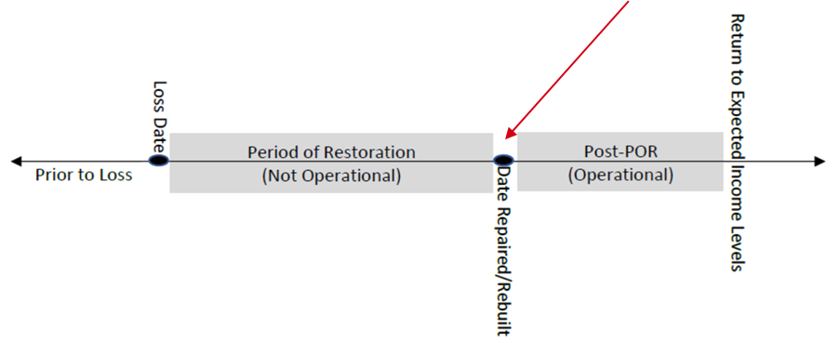
When Does the Period of Restoration End
End of “Period of Restoration”
Ends on the earlier of:
  (1) The date when the property at the described premises should be repaired, rebuilt or replaced with reasonable speed and similar quality; or
  (2) The date when business is resumed at a new permanent location.
  From ISO CP 10 30 and CP 10 32

Slide 11
End of “POR” Not Same as Returning to Pre-Loss Income Levels
Although the insured has reached the end of the “Period of Restoration,” the operation may not immediately return to pre-loss operational income levels.

Slide 12
The Result: Two Income Loss Periods
Business Income Loss
Extended Business Income Loss

Slide 13
Securing Payment for Extended Business Income
ISO’s base Business Income policies (CP 00 30 and CP 00 32) provide a limited amount of coverage under Additional Coverage 5.c. Coverage for Extended Business Income is limited to the earliest of:
  The insureds return to pre-loss operational income levels; or
  60 consecutive days
If this length of coverage is not enough, the insured must:
  Decide how much additional coverage is needed; and
  Include that amount on the CP 15 15 (K.2.).
No endorsement required to lengthen period. The Extended Business Income Additional Coverage of Form CP 00 30 and Form CP 00 32 may be extended to cover additional loss of Business Income beyond 60 days by activating this Optional Coverage in the Declarations. (Rule 51.D.)

Slide 14
Optional Periods Available
Optional Extended Periods of Indemnity available (Per Rule 51.D.)
90 Days
120 Days
150 Days
180 Days
270 Days
365 Days
450 Days
540 Days
630 Days
730 Days

Slide 15
Limitations on Use
Per Rule 51.D.
Cannot be used with the Maximum Period of Indemnity
Cannot be used if coverage is written on a no-coinsurance basis.
This option not available for extra expense protection

Slide 16
Dependent Property Exposures
Business Income covers loss of business income when a covered cause of loss damages an insured location resulting in a suspension of operations.
Damage to dependent properties is NOT covered by the unendorsed Business Income Coverage Form.
Rule 51.B.: The Business Income From Dependent Properties Forms…provide coverage for loss of business income sustained when the suspension of the insured's operations is caused by direct loss or damage to described Dependent Property.

Slide 17
What is a “Dependent Property” (Rule 51.B.)
Dependent Property is property that the insured depends on:
Contributing Location (“Suppliers”)
Recipient Location (“Buyers”)
Manufacturing Location (“Providers”)
Leader Location (“Drivers”)
The Dependent Property must not be owned, operated or controlled by the insured.

Slide 18
The CP 15 15
In a sense, it’s Time Element’s equivalent of the property schedule in ISO’s Statement of Values (CP 16 15)
A valuable tool in the Business Income underwriting process
Designed to help the Insured and Agent Develop the 12-month estimated Business Income exposure and the ultimate limit of coverage

Slide 19
Worksheet Details
Four Columns
  Two for Manufacturing
  Two for Non-Manufacturing
Can be Divided into Two Halves
  Two columns on right request information about the year ENDING
  Second set of columns requests information about the UPCOMING year (estimated data)
The ESTIMATED column is for the coming policy period
Most of the Information for Completing the Worksheet can be Found in the Year-End Income Statement
Does not always follow GAAP

Slide 20
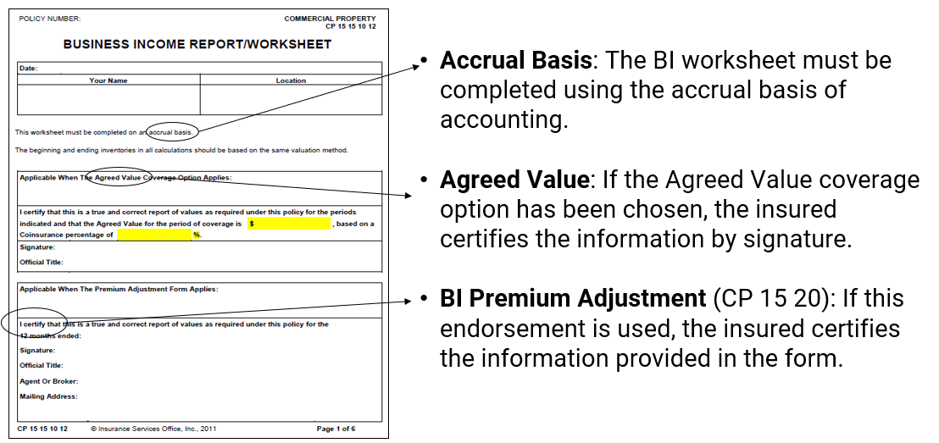
Page 1 – Information Page

Slide 21
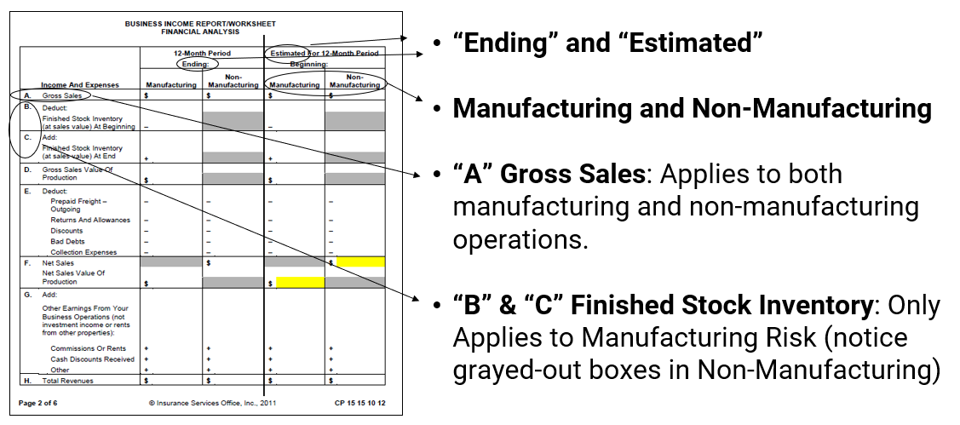
Page 2: Income & Expense Calculation

Slide 22
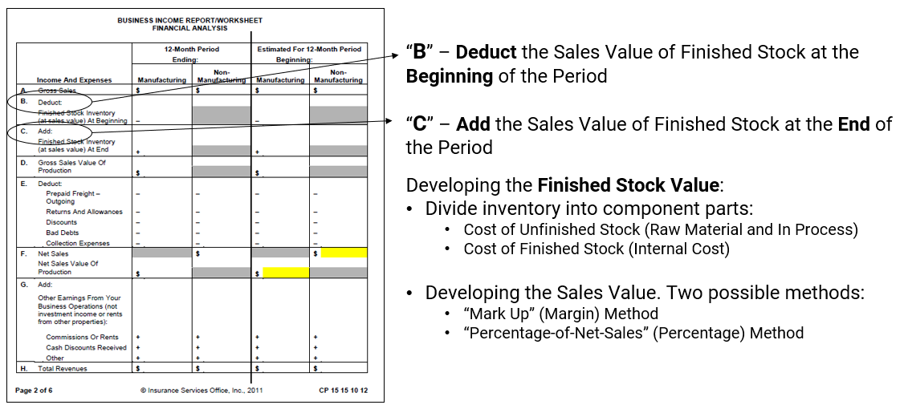
Page 2: Sales Value of Finished Stock

Slide 23
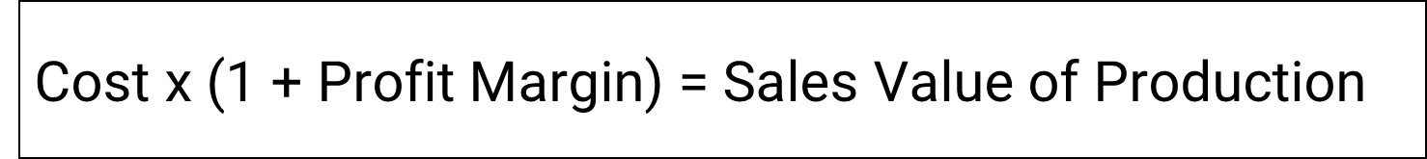
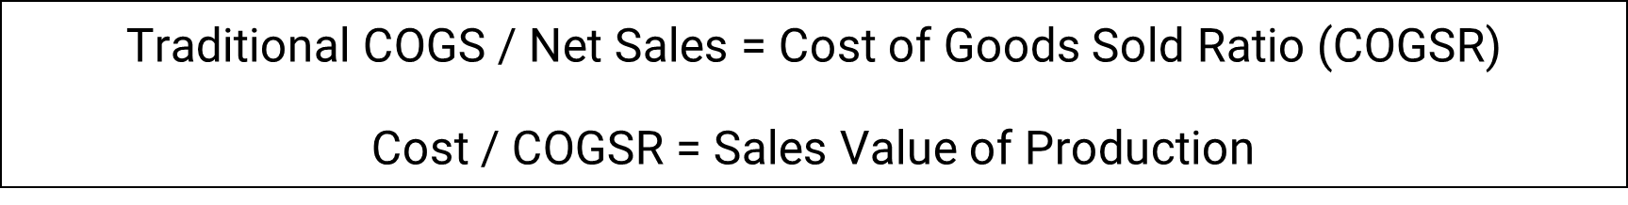
Possible Methods for Developing Sales Value
“Mark Up” (Margin) Method
“Percentage of Net Sales” (Percentage) Method

Slide 24
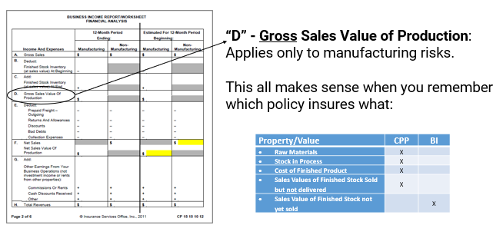
Page 2: Gross Sales Value of Production
Property/Value | CPP | BI
Raw Materials | X
Stock in Process | X
Cost of Finished Product | X
Sales Values of Finished Stock Sold but not delivered | X
Sales Value of Finished Stock not yet sold |  | X

Slide 25
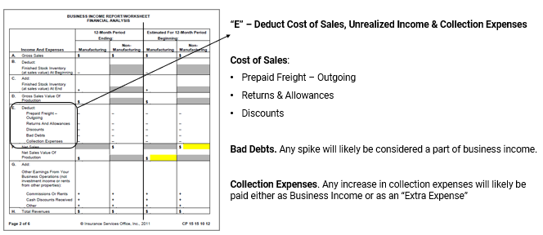
Page 2: Cost of Sales, Unrealized Income & Collection Expenses

Slide 26
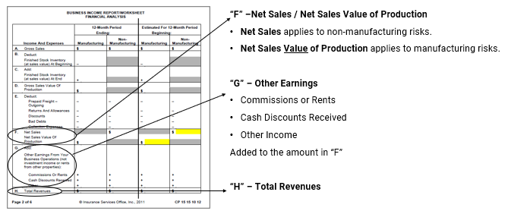
Page 2: Net Sales & Total Revenues

Slide 27
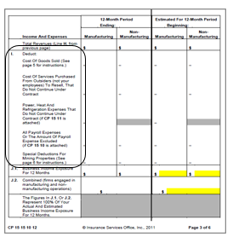
Page 3: Subtracting Expenses
Five Deductions to Arrive at 12-Month Business Income
Cost of Goods Sold: (See page 5 for instructions)
Cost Of Services Purchased From Outsiders…To Resell, That Do Not Continue Under Contract
Power, Heat and Refrigeration Expenses That Do Not Continue Under Contract (if CP 15 11 is attached)
All Payroll Expenses Or The Amount Of Payroll Expense Excluded (if CP 15 10 is attached)
Special Deductions for Mining Properties (See page 6 for instructions)

Slide 28
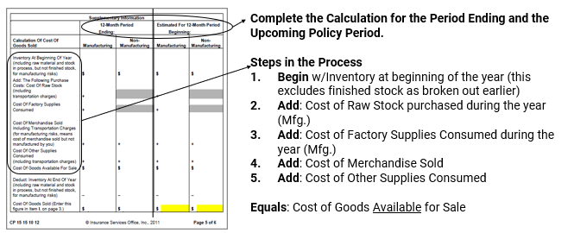
Page 5: Cost of Goods Sold

Slide 29
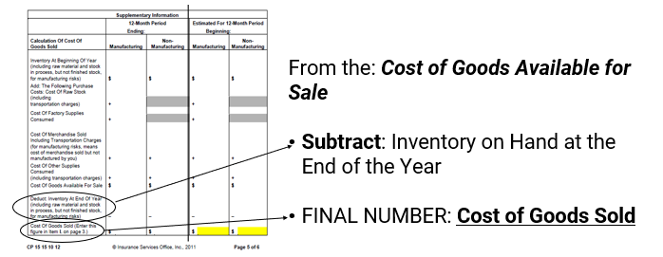
Page 5: Cost of Goods Sold

Slide 30
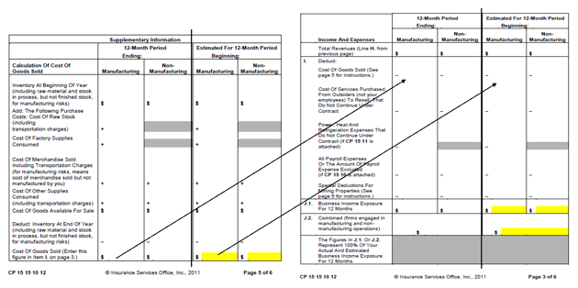
Page 5: Cost of Goods Sold

Slide 31
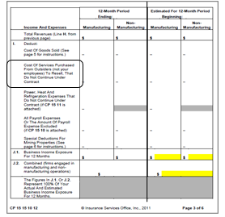
Page 3: Subtracting Expenses
Cost of Services Purchased from Outsiders… To Resell, That Do Not Continue Under Contract
Applies to outside services billed by the insured as part of their services
If there is a contract requiring payment regardless of production, then this cost is NOT deducted.

Slide 32
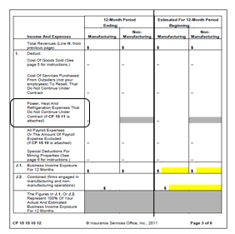
Page 3: Subtracting Expenses
Power, Heat And Refrigeration Expenses That Do Not Continue Under Contract
If the CP 15 11 is attached
Most commonly seen with manufacturing operations

Slide 33
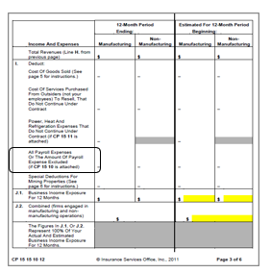
Page 3: Subtracting Expenses
All “Payroll” expenses or the amount of payroll expenses excluded
If CP 15 10 is attached
Based on several options (i.e., position, days, contracts)

Slide 34
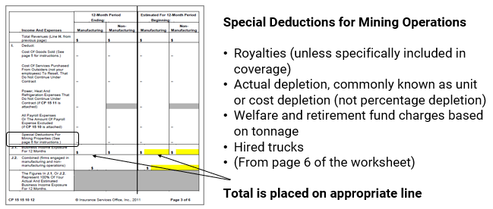
Page 3: Subtracting Expenses

Slide 35
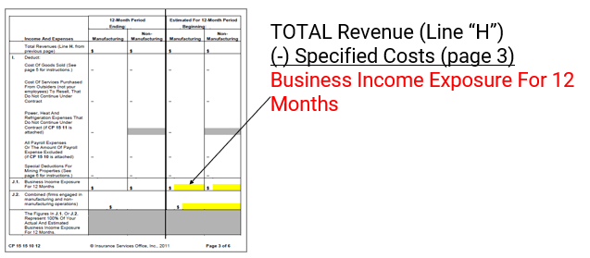
Page 3: 12-Month Business Income Exposure

Slide 36
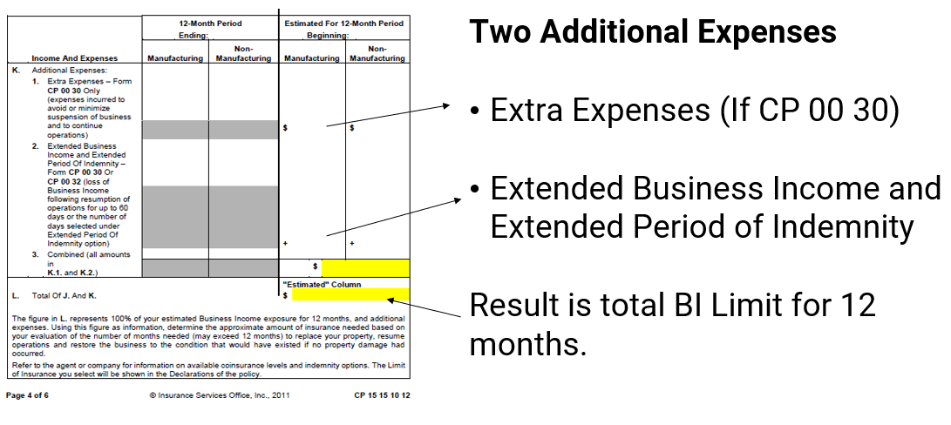
Page 4: Additional Expenses

Slide 37
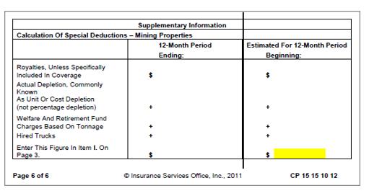
Page 6: Mining Properties

Slide 38
No part of this presentation may be copied or redistributed without the prior written consent of Verisk. This material was used exclusively as an exhibit to an oral presentation. It may not be, nor should it be, relied upon as reflecting a complete record of the discussion.

Slide 39
Christopher J. Boggs, CPCU, ARM, ALCM, LPCS, AAI, APA, CWCA, CRIS, AINS
Sr. Product Manager
Christopher.boggs@verisk.com

