Slide 1
Industry Session
Spring Conference March 20, 2024

Slide 2
Political/Legislative Update

Slide 3
Political Update
170 Legislative seats up for election in 2024
46 Senate
124 House
Important dates
Filing period: 3/16/24 – 3/30/24
Primaries: 6/11/24
Runoffs (if needed): 6/25/24
General: 11/5/24

Slide 4
S.C. DOI 2024 Agenda
“Clean-up”/ DOI Procedures bill (H 4869/ S 957)
Adjuster licensing (S 1032)

Slide 5
Other items
Mandates:
S 33 – Mandatory liability for boats and PWCs
H 3950 – Earthquake insurance
H 4565 – New car replacement

Slide 6
Other items
Market availability issues:
S 1062/ H 5262 – Excess insurance premium tax credit
H 5066 – Liquor liability insurance
S 1048 – Dram shop liability
S 844 – Insurance study committee

Slide 7
Other items
Regulatory issues:
S 1050 – Prior approval for liquor liability insurance rates
H 3977 – E-posting of insurance documents

Slide 8
H 3977
Notwithstanding another provision of this section, if a standard property and casualty insurance policy or endorsement does not contain personally identifiable information, an insurer may mail, deliver, or post the policy or endorsement on the insurer's website. If the insurer elects to post an insurance policy or endorsement on the insurer's website in lieu of mailing or delivering the document to the insured, the insurer must comply with the following conditions:
(1) The policy and endorsement must be accessible as long as the policy or endorsement is in force.
(2) After the policy expires, the insurer must maintain and archive the policy and endorsement for five years after the expiration of the policy and shall make the documents available to the party upon request.
(3) The insurer must post the policy and endorsement in a manner that allows the insured to print and save the policy and endorsement using a program or application that is widely available on the Internet and free to use.
(4) The insurer provides the following information in, or simultaneous with, each declarations page provided at the time of issuance of the initial policy and any renewals of that policy:
(a) a description of the exact policy and endorsement form purchased by the insured;
(b) a method by which the insured may obtain, upon request and without charge, a paper copy of the policy; and
(c) the Internet address where the insured's policy and endorsement is posted.
(5) The insurer provides notice, in the format preferred by the insured, of any changes to the form or endorsement, the insured's right to obtain, upon request without charge, a paper copy of a form, and the Internet address where the form and endorsement is posted.

Slide 9
2024 Legislative Priorities
S 533 – Contribution among tortfeasors

Slide 10
Regulatory Updates
S.C. DOI Commercial Liability Insurance Data Call
Liquor Liability
Commercial Auto
Commercial General Liability

Slide 11
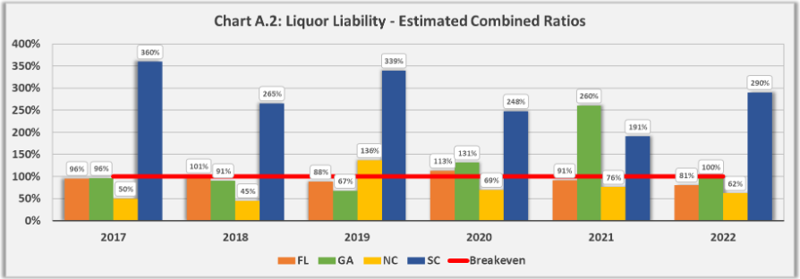
Regulatory Updates
Liquor liability

Slide 12
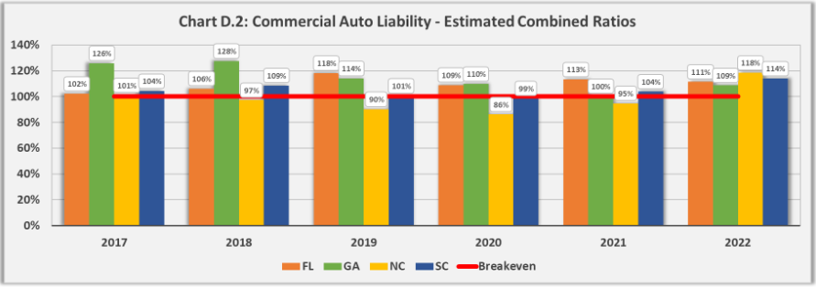
Regulatory Updates
Commercial auto

Slide 13
Regulatory Updates
Commercial auto

Slide 14
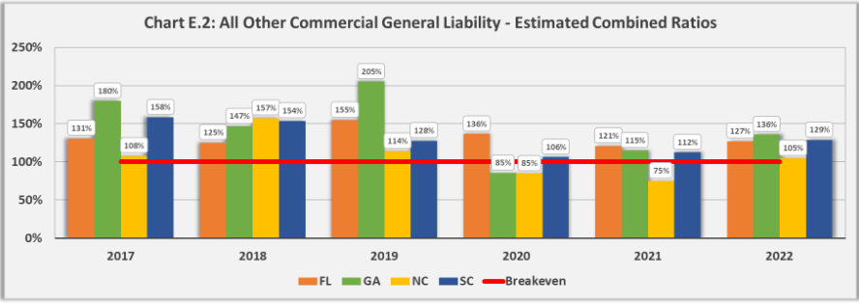
Regulatory Updates
Commercial general liability

Slide 15
Media
Liquor Liability
Tort Reform
Auto insurance
Homeowners insurance (property)
Hurricanes/climate

Slide 16
Questions?

Slide 17
Industry Session
Spring Conference March 20, 2024

