Slide 1

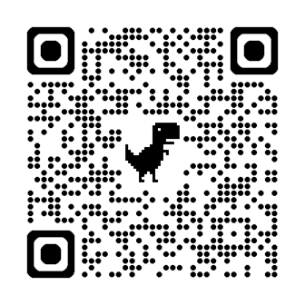
​ "Your Agency's Supply Chain -- The Cybercriminals Playground"

Slide 2
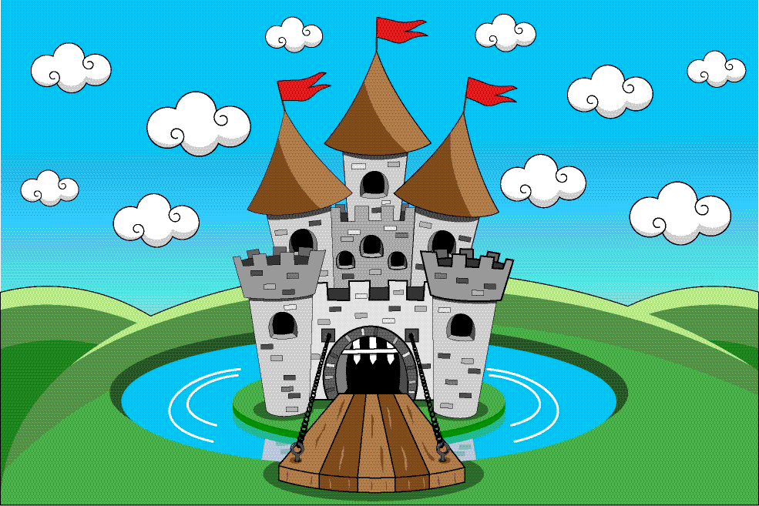

Slide 3
KEEPING UP
WITH THE PACE OF CHANGE

Slide 4
91% of small businesses believe AI will drive future growth, with 77% planning to adopt new technologies, including AI.
75% of SMBs are at least experimenting with AI, with growing businesses leading in adoption at 83%.
It’s all about efficiency. You're doing 10 jobs. Your team is stretched. Cash is tight, time is tighter, and competition is relentless.
59% of insurance sector breaches caused by third-party attacks.

Slide 5
Rapid Evolution of LLMs
GPT, Copilot, Claude, Nemotron, Gemini, LLaMa, Qwen, Mistral, CommandR, DeepSeek, Grok, Inflection,Gemma, Jamba, Pythia, Falcon

Slide 6
1. Artificial Intelligence and Insurance Agents - Panic or Promise? (One-hour or two-hour versions)
2. Digital Marketing: The Old Techniques Don't Work As They Used To (One hour)
3. Artificial Intelligence and Cybercrime: The Two-Edged Sword for Agencies and Policyholders (One-hour)
Explosive Cybercrime Growth
Cyber criminals hijacked 9%
of the world economy last year.

Slide 7
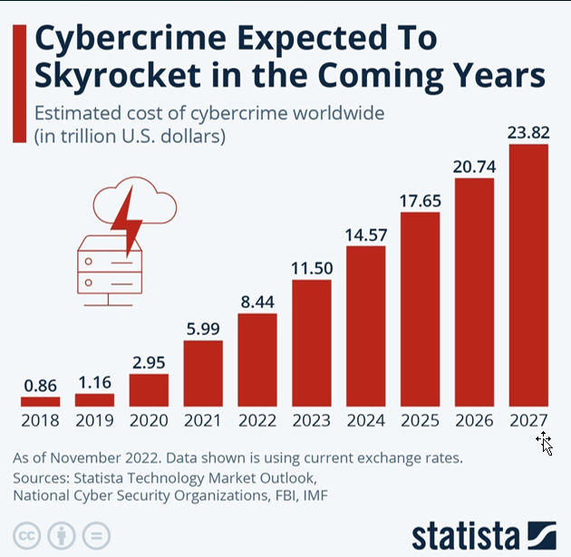

Slide 8


Slide 9


We are all connected in the digital world.

Slide 10





























Slide 11



















Slide 12
Challenges of Using AI
Cybersecurity
Data Privacy
Productivity
Compliance

Slide 13
Demystifying AI
Narrow Artificial Intelligence
Artificial General Intelligence
Large Language Models

Slide 14
Why Use AI?
Content creation
Document management
Automated underwriting & risk analysis
Sales call summaries, CRM updates
Chatbots, virtual assistants
Market research, competitive analysis
Social media management, scheduling
Hiring, resume screening
Process & workflow automation

Slide 15
AI Assistants
Video Generation
Image Generation
Automation
Research
Writing
Search engines
Graphic Design
Knowledge Management
Email
Scheduling
Presentations
Resume Builders
Voice Generation
Music Generation
Marketing

Slide 16
Why Cybersecurity
Is Mission-Critical For Agents
Everyone is a target in the digital ecosystem.
Constant breaches plant the seeds of policyholder distrust - breaches of major consumer brands, insurers, vendors
AI supercharges criminal activity.
Risk transfer, by itself, is only a partial solution.

Slide 17
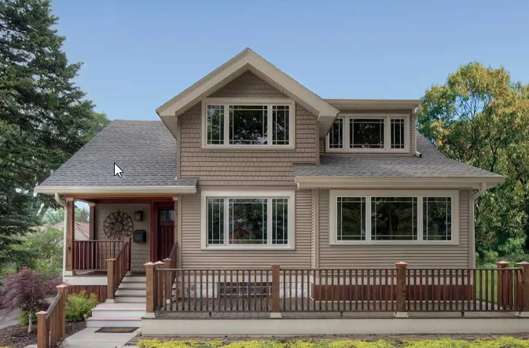

Slide 18
Your Attack Surface
All the vulnerabilities, pathways, or methods that hackers can use to gain unauthorized access to your network, sensitive data, or to carry out a cyberattack.
Digital attack surface (Weak passwords, misconfiguration, software, operating system, Internet-facing assets, shared databases and directories, outdated or obsolete devices, data, or applications, shadow IT
Physical attack surface (Malicious insiders, device theft, baiting)
Phishing has moved outside of the mailbox. (phishing, sharing information they shouldn’t share, downloading software they shouldn’t download, visiting websites they shouldn’t visit, sending money to criminals, employee use of social media, instant messaging apps and responding to a search engine ad.

Slide 19
What Cybercriminals Like About Artificial Intelligence
Enables faster creation, deployment of malware (without detection) and business email compromise (BEC)
Facilitates circumvention of “good” AI tools.
Automated phishing attacks and impersonation attacks (real individuals, organizations, identity thefts and fraud.
Using chatbots to send voice messages pretending to be a trusted friend, colleague, or family member.
Social engineering attacks - voice cloning and deepfake technology to make it look like someone is saying something incendiary.

Slide 20
What Cybercriminals Like About Artificial Intelligence
Fake customer support chatbots, e.g., fraudulent bank site using a customer service chatbot to manipulate unsuspecting victims into disclosing sensitive personal and account information.
Facilitates the creation of fake images and audio of people.
Eliminates the need for hackers to be sophisticated programmers (Worm GPT, Fraud GPT, Poison GPT).
AI is a force multiplier: Attackers are moving faster, more effectively. Pressure to keep pace with creates a state of perpetual hyper-vigilance.

Slide 21
Top Cyber Threats
The rise of deepfakes and synthetic media as part of phishing campaigns.
Hackers using LLMs to orchestrate rapid-fire cyberattacks without human direction.
Escalation of ransomware powered by AI.
Attackers are getting better at finding security loopholes, unprotected infrastructure ways to hide their network communications.
Prompt injection, data poisoning.
Static and scheduled network scans leave gaps in time.
Multicloud blind spots and evasion of EDR and CNAPP

Slide 22
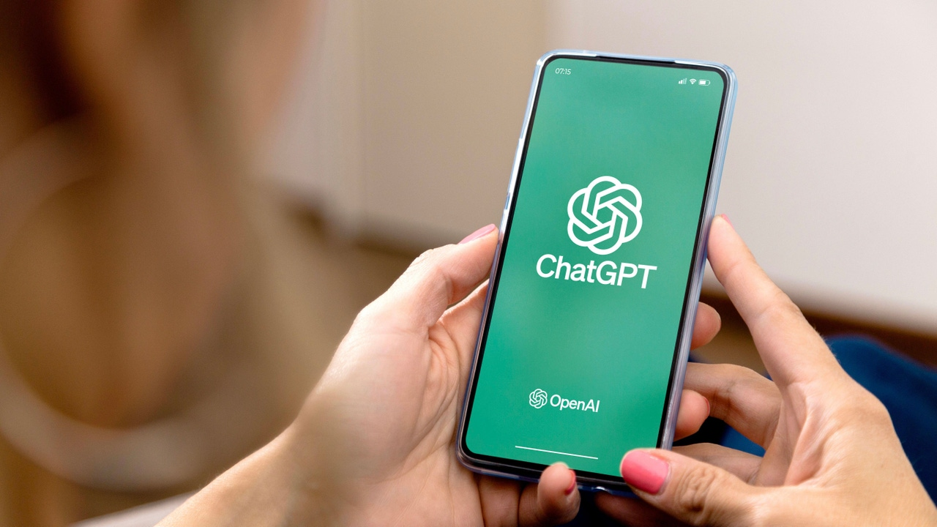
Criminal Hackers Add GenAI Credentials to Underground Markets

Slide 23
Deepfakes
Source video deepfakes
Audio deepfakes
Lip syncing
Artificial Claims

Slide 24
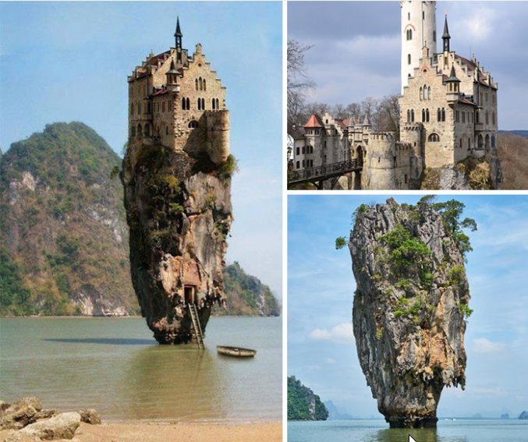
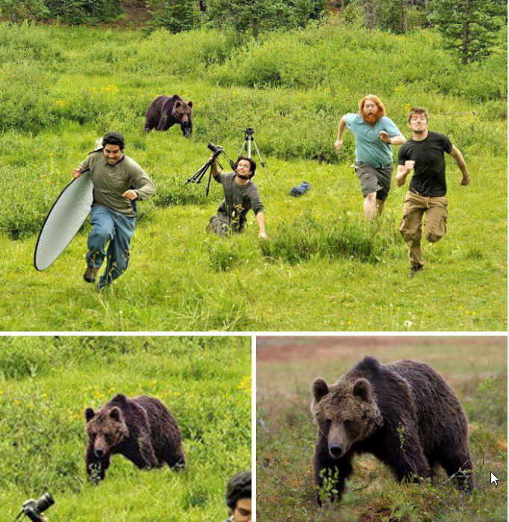

Slide 25
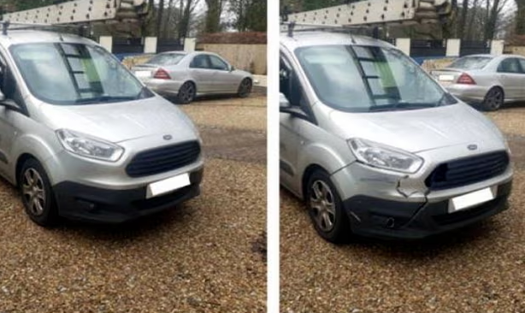
Shallow Fakes

Slide 26
Any Image Can Be a Fake
Use common sense. If the image is used to emotionally manipulate you, it may be part of a social engineering attack.
Search for the image on the internet, though cyber criminals can manipulate Google search results.
If something doesn't feel right, verify the source and trace back the image for any contextual information.
Free detection test, https://detectfakes.kellogg.northwestern.edu/

Slide 27
Why Cybersecurity Matters for Agents
Weak cyber defenses reduce an insurance agency's value.
Digital breadcrumbs used to steal identities to gain vendor access or just sell.
The compromise of large language models, now used to orchestrate rapid-fire cyberattacks without human direction.
Rapid growth of third-party data breaches, 30% of all data breaches stem from third-parties, nearly double from 2024. Third-party breaches are the third highest predictor of increased breach costs, increasing costs by 5% above the average. 59% of insurance sector breaches are caused by third-party attacks.
Larger businesses haver strengthened defenses so hackers are incentivized to target smaller subcontractors. Small businesses slow to adopt strong practices.

Slide 28
The Latest Cybercrook Schemes
Fake invoices directly from Docusign -- no malicious links or attachments because the danger lies in the authenticity of the request itself.
Criminals harvest ChatGPT credentials to sell them on the dark web.
Hackers have launched a phishing campaign through Calendly to steal Google account credentials.

Slide 29
AI Exploits Security Weaknesses
Cybersecurity is a service, not a commodity. “Set it and forget it” is a risky defense strategy.
Firewalls can be breached more easily than ever.
MFA is not foolproof and has been breached.
The new MFA is MDR.

Slide 30
Strong Cybersecurity Defense Pays
(For agencies and policyholders)
Triggers premium discounts
Obtain better sublimits
Avoid breach penalties
Competitive advantages
Reduces claim severity
Insurtech challenges caveat

Slide 31
Agency Agreements Are Changing – Again
“The parties agree to safeguard data according to all commercially reasonable administrative, physical and technical standards and in accordance with applicable laws and regulations. Additionally, the parties agree to reasonably comply with due diligence and periodic security assessment requests that are needed to confirm its security practices.”
“…each party will notify the other without undue delay, but in no event more than 24 hours after discovery of a cybersecurity breach or a possible cybersecurity breach in which the other’s confidential information is or is suspected to have been lost, stolen, improperly altered, improperly destroyed, improperly used, or improperly accessed.”
“You agree to distribute privacy disclosures to applicants and holders of our policies and accounts in accordance with such laws and as required by us. You further warrant to maintain security safeguards to protect customer information that matches or exceeds standards for insurance agents.”

Slide 32
AI Governance
If using a large language model (LLM) such as ChatGPT, how is your agency using it?
Create written guidelines for employees on their use of an LLM and any AI tool. Spell out who may use it, for what purpose and what data can be inputted.
Evaluate AI-powered tools and programs with specific performance and data security criteria.
Create inventory of AI-powered tools used by the agency and its vendors.

Slide 33
Cyber Governance
Patch Management (Zero-day attacks)
Firewalls have limited value. Use defense-in-depth approach.
Multi-Factor Authentication
Managed Detection & Response (MDR)
Avoid Risky Technologies
Add cybersecurity as factor in choosing vendors.
Comprehensive Cyber Risk Assessment (internal and supply chain) every year and defense upgrades to match advances by cyber criminals.
Create incident response plan.
Cybersecurity is a service, not a commodity. One-and-done is a risky defense strategy.

Slide 34
Incident Response Plan Disaster Recovery Plan
(Action steps after cyberattack) Restoring data
Identify response team Restarting applications
Breach notifications Plan testing/revisions
Detection/Analysis
Containment

Slide 35
Fighting Back
Use AI to fight cybercrime (but only as part of comprehensive cyber defense)
Immediate, real-time response is critical.
Help policyholders better understand the cybercrime threat and how to mitigate the risk.
Add cybersecurity as a factor in choosing vendors. (Data location, compliance certifications, training process, policy/procedures on data governance).
Comprehensive Cyber Assessment every two years and regular defense upgrades.

Slide 36
Final Takeaways
Cybersecurity must be constant because cybercrime is always changing, not just the direct attacks but those on vendors.
Firewalls and anti-virus tools have limited value, create false sense of security.
Prevention is the best defense -- demands staying two steps ahead of cybercriminals.
Do not assume, know your risks in detail with a cyber risk assessment and needed steps to fix weaknesses.
Become a cybersecurity advocate for your clients and their data. You are selling more than insurance, you are selling TRUST.

Slide 37
SPECIAL OFFER

Slide 38
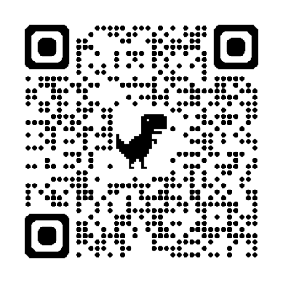
THANK YOU!
Website: www.wetzelandassociates.com
Email us at twetzel@wetzelassoc.com
Phone: Call or text at 708-446-2973.
Calendly: https://calendly.com/twetzel-1

