Slide 1
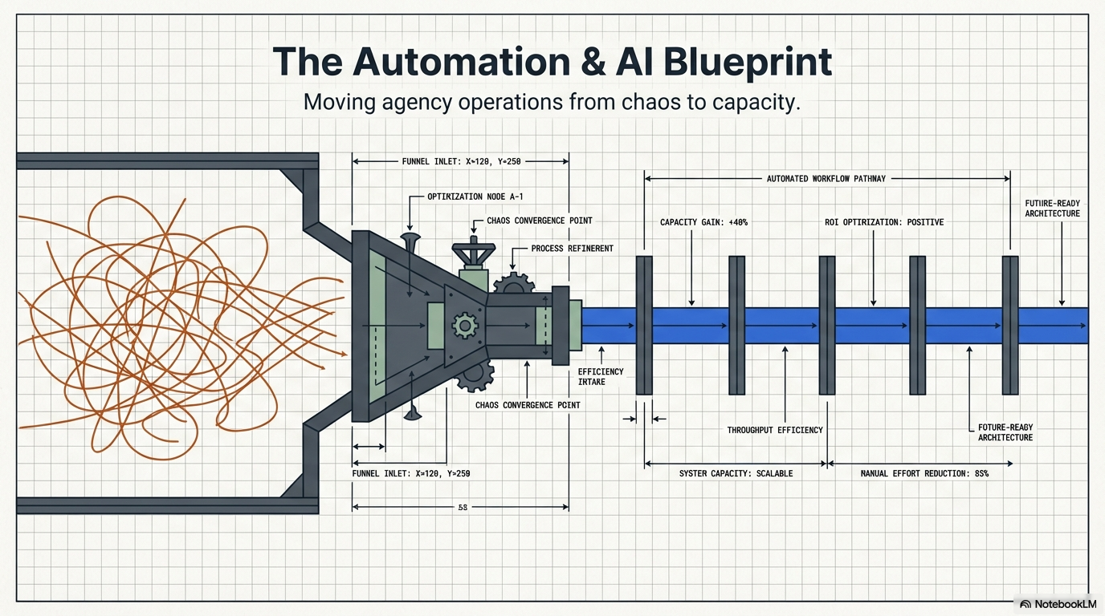
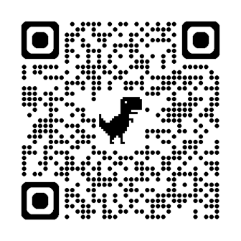

Slide 2

We make understanding insurance tech EASY.

Slide 3
Stop spending time trying to solve your technology needs alone.

Slide 4
Let us guide you so you can focus on your clients, grow your business, keep up with competitors, and add value to your agency.

Slide 5
SUCCESS JOURNEY
NEW TECH ASSESSMENT
GUIDES & REVIEWS
CONSULTING & COACHING
STATE OF TECH REPORT
SOLUTION PROVIDER PROFILES
TECH SELECTORS
WEEKLY TECHTIPS
Flagship Tools
(free)

Slide 6
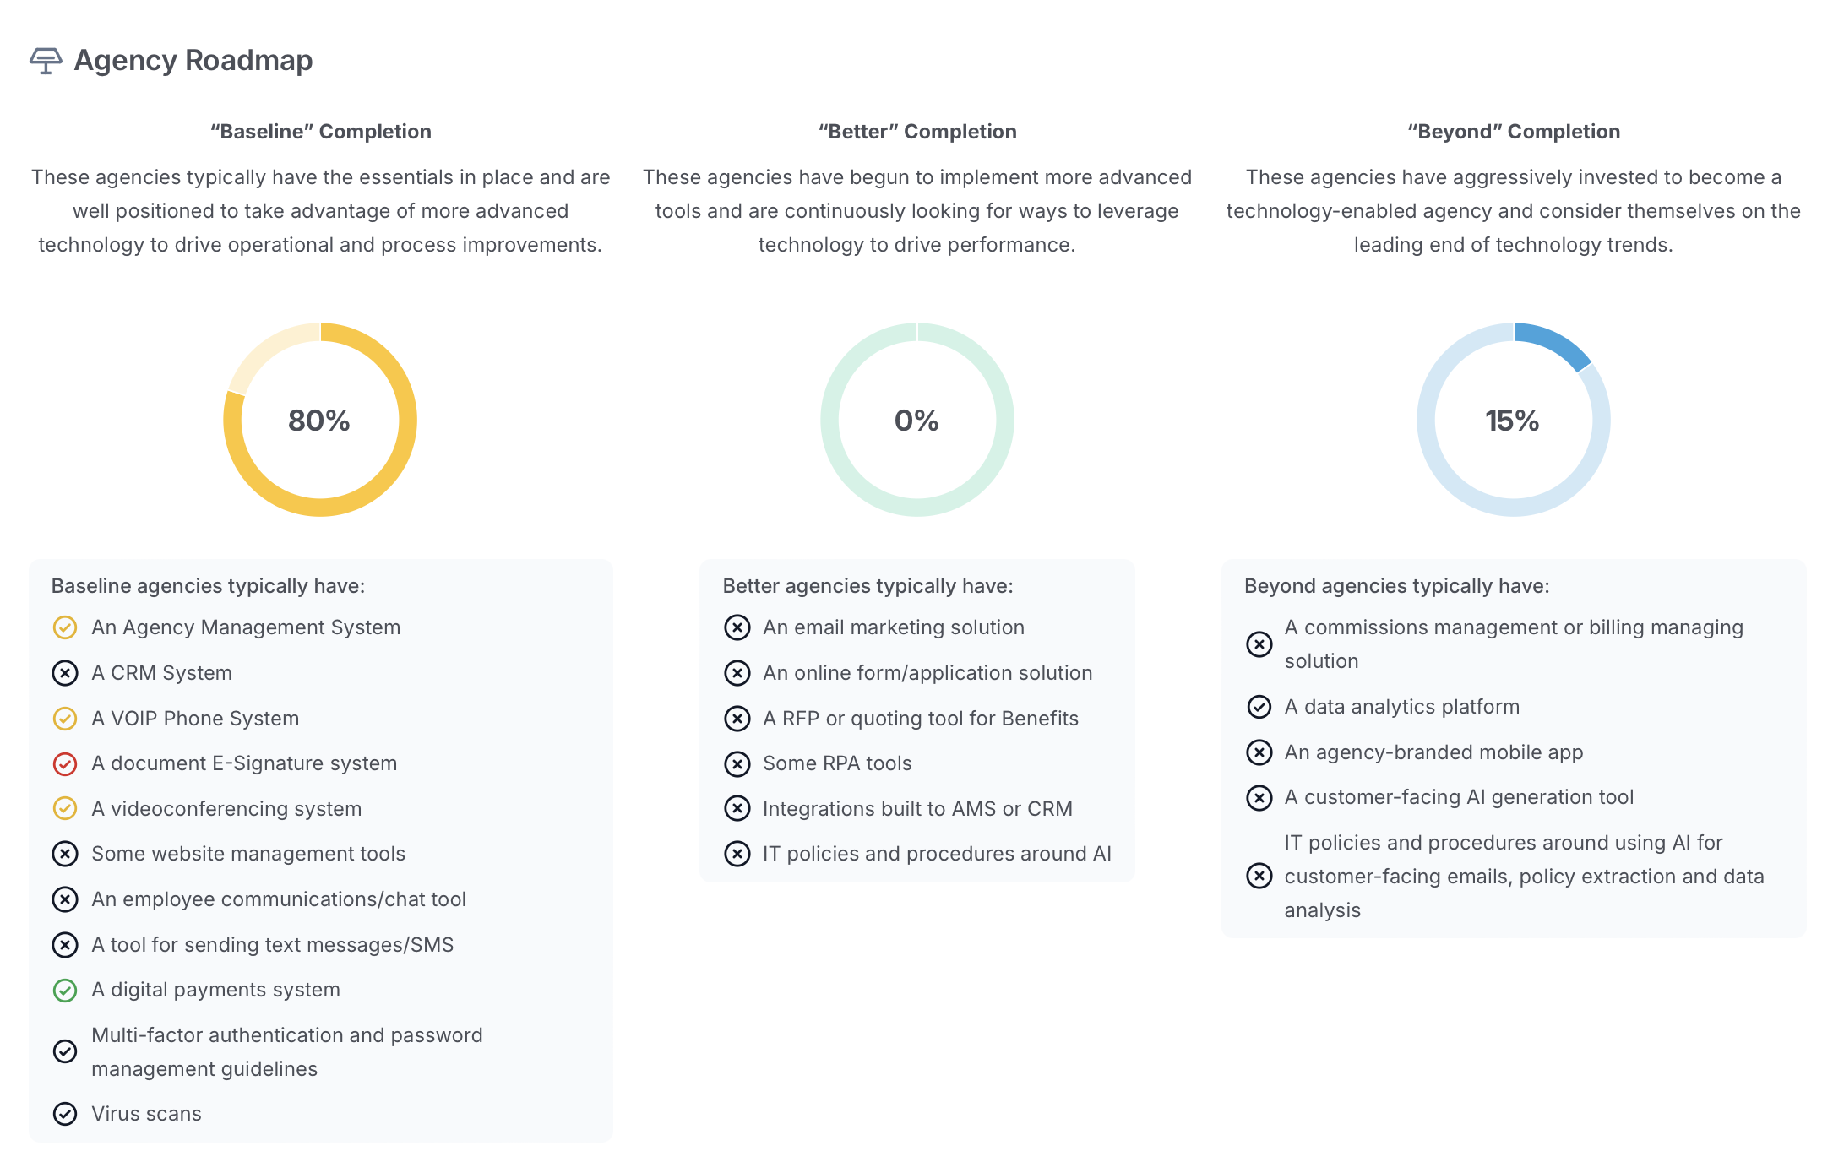

Slide 7
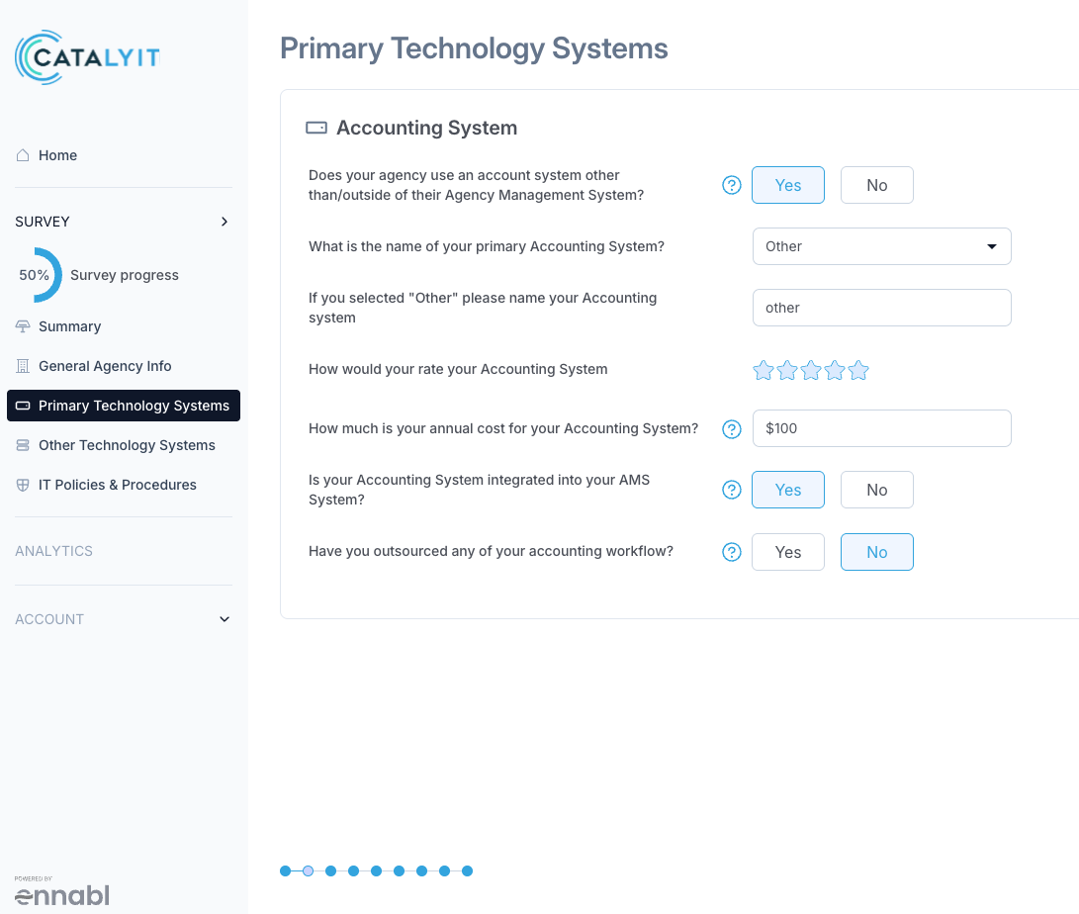

Slide 8
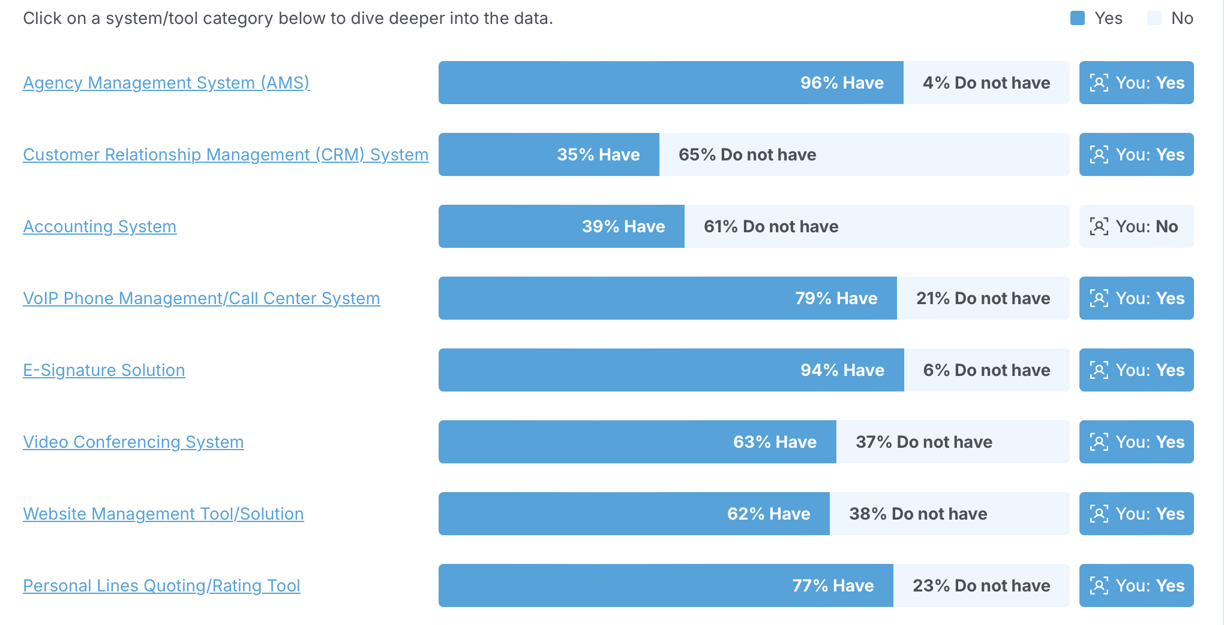

Slide 9
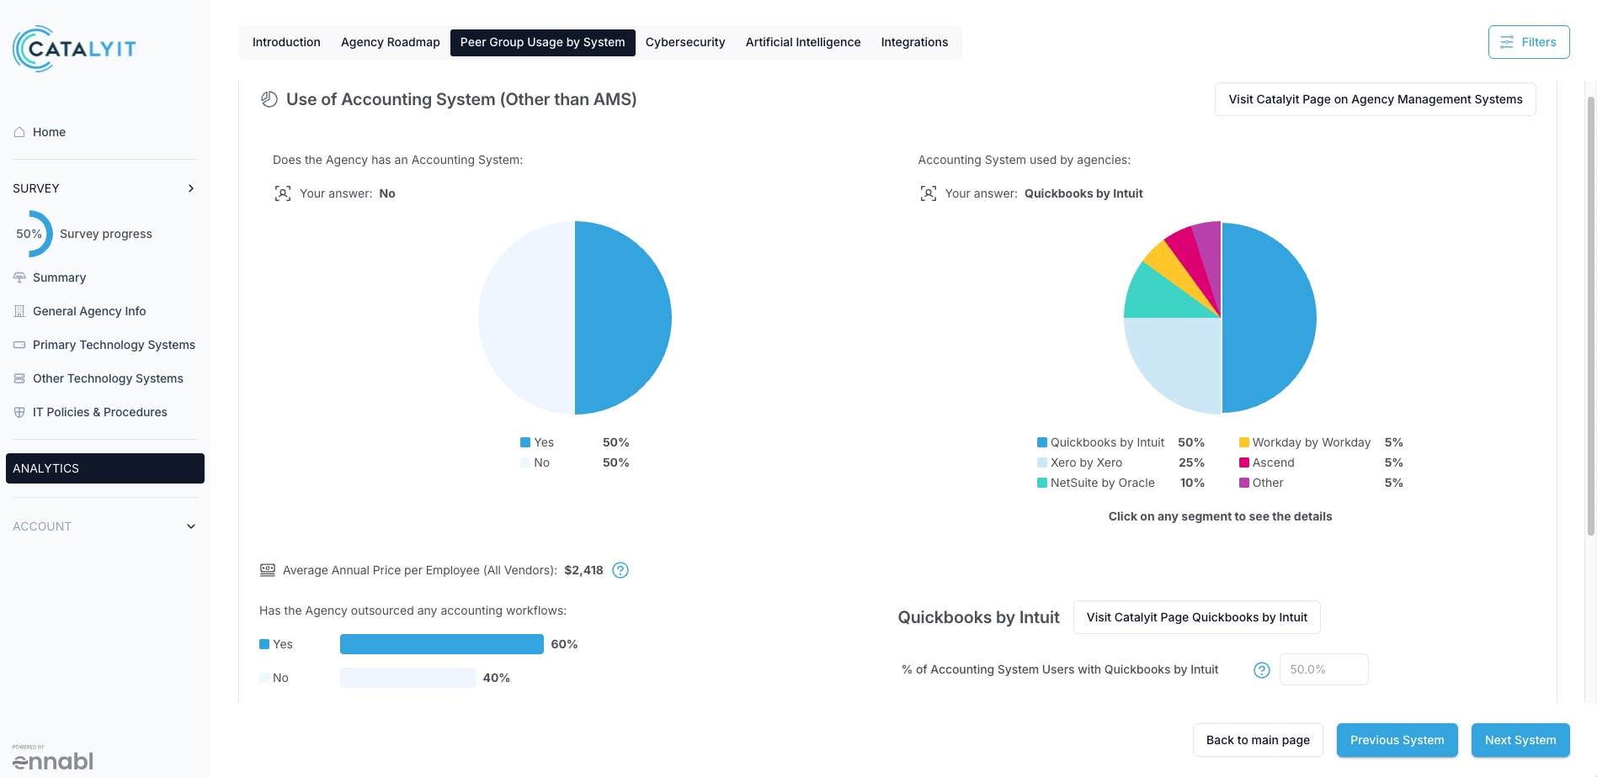

Slide 10
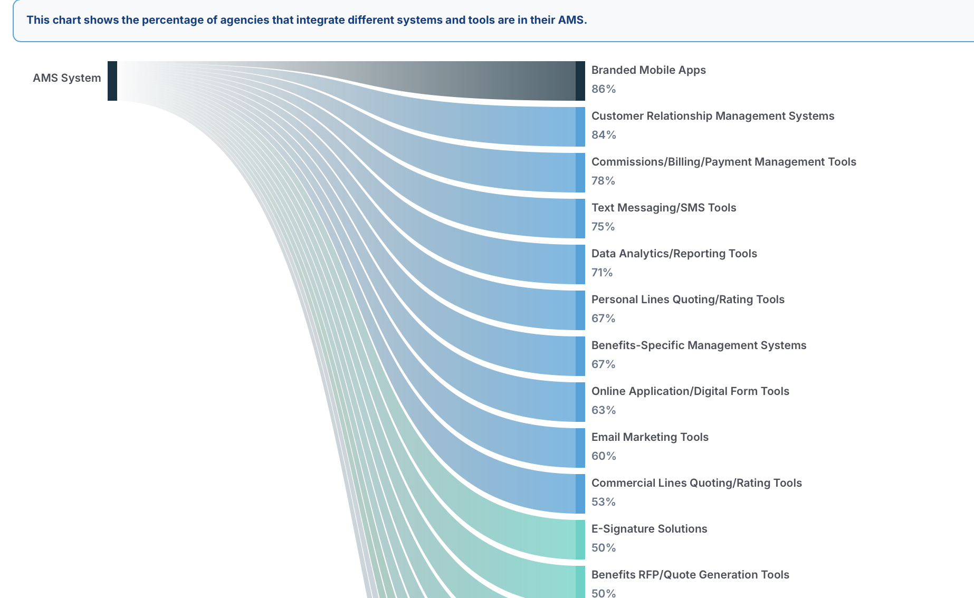

Slide 11
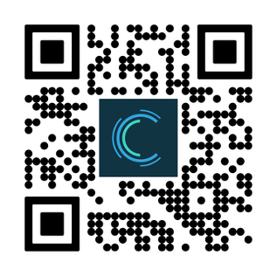
Take the Tech Assessment

Slide 12
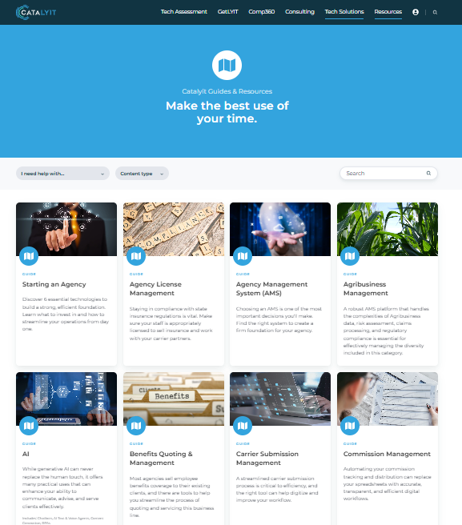
GUIDES & reviews
Notes:
https://catalyit.com/guides
Catalyit Guides & Resources
Explore Catalyit’s insider-created guides to compare insurance tech solutions, save time, and make smarter decisions for your agency.
catalyit.com
Top 3 Most-Viewed Guides 1. AI Guide 2... by Jason Furst
Jason Furst (External)
5:08 PM
Top 3 Most-Viewed Guides
1. AI Guide
2. Starting an Agency
3. Quoting Platforms – Personal

Slide 13
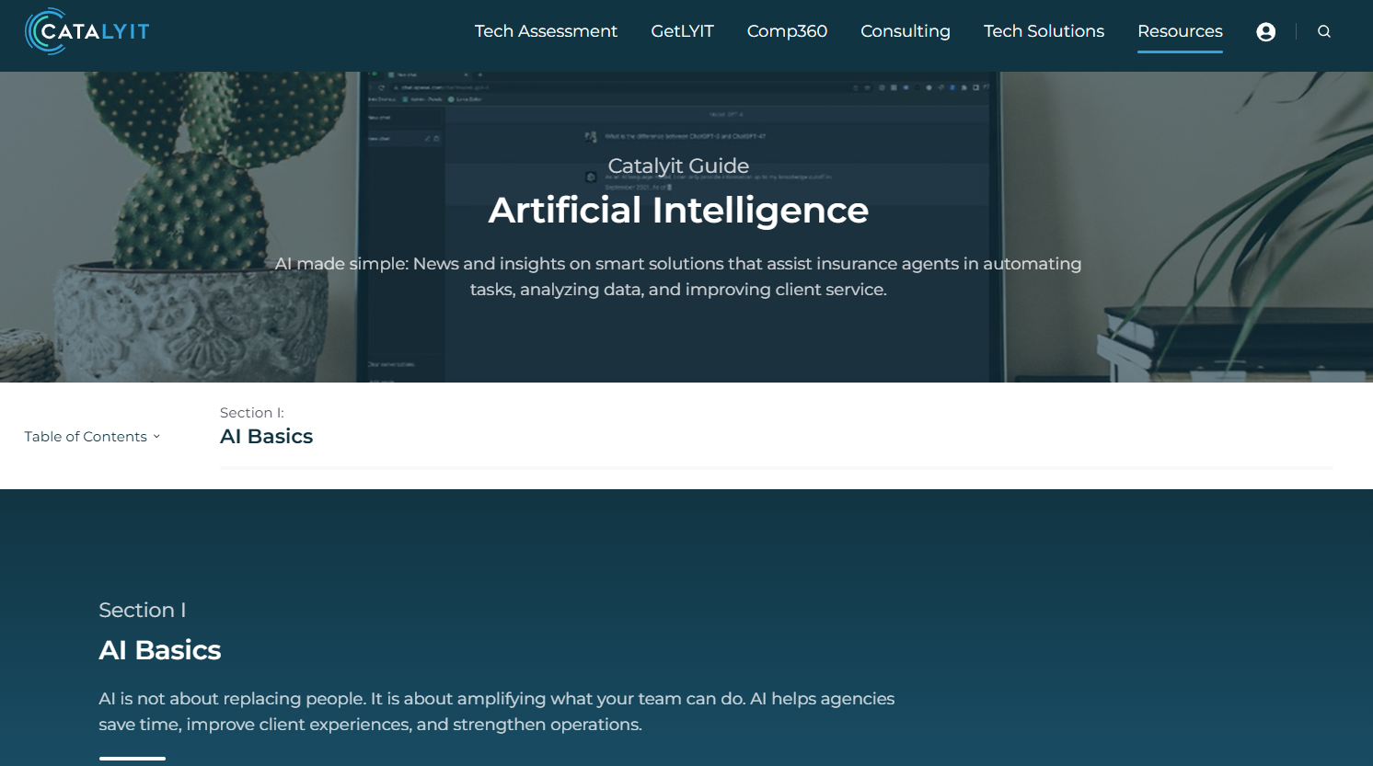

Slide 14
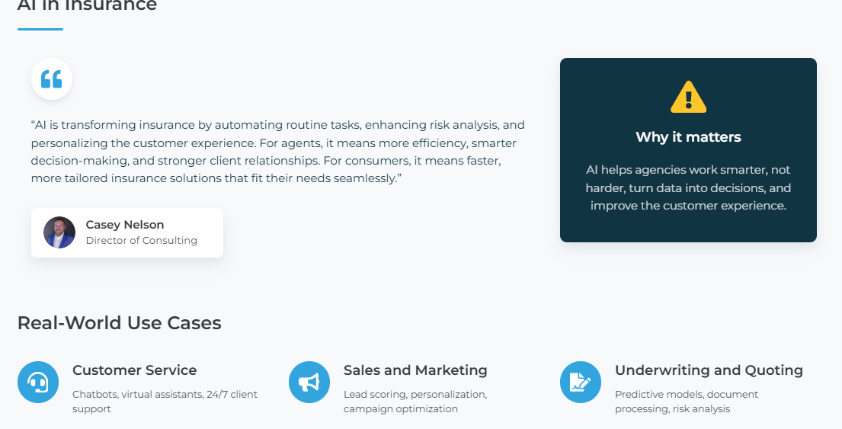

Slide 15
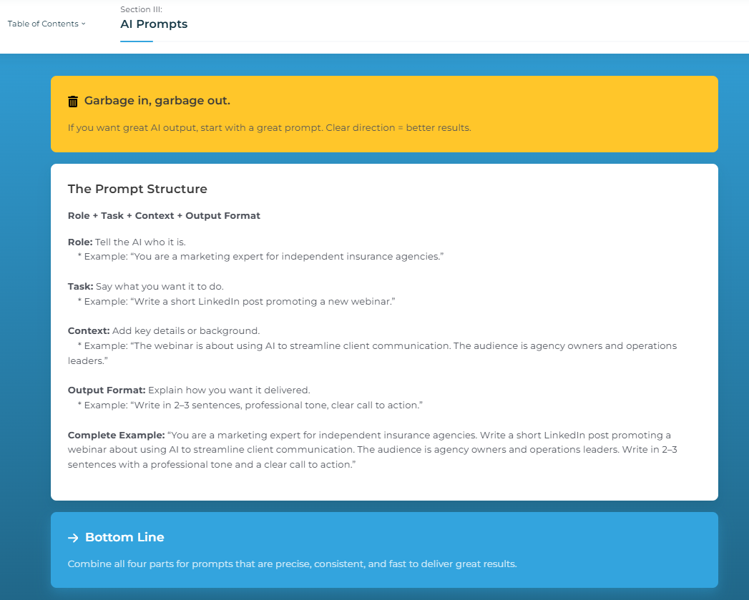

Slide 16
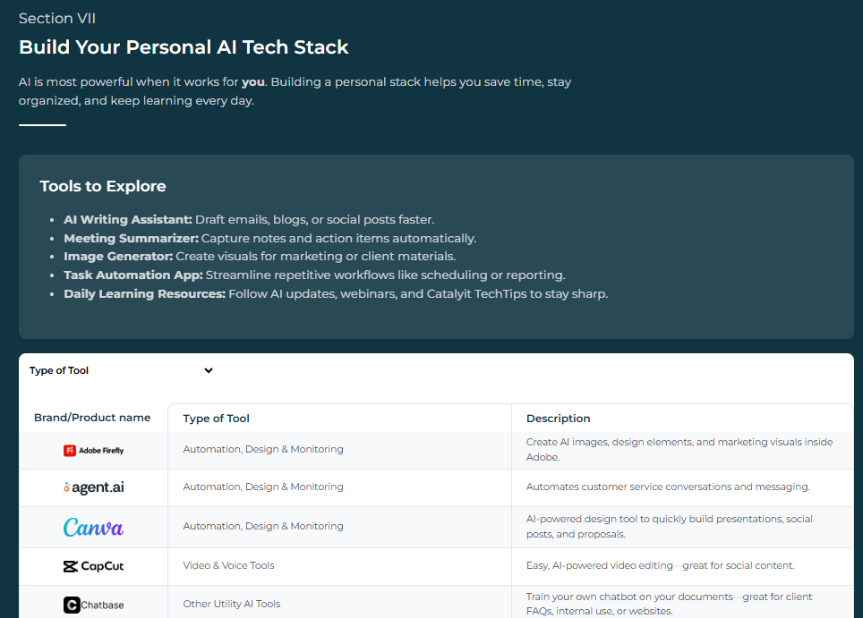

Slide 18
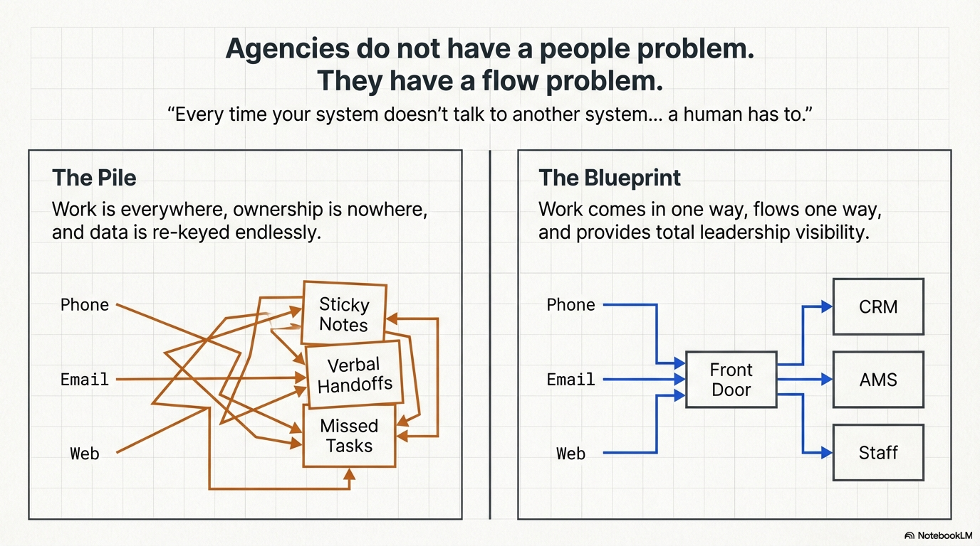

Slide 19
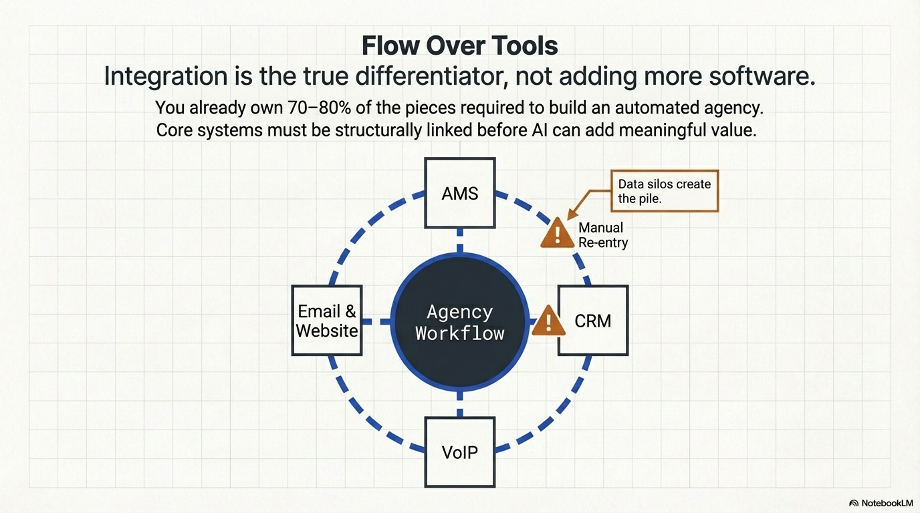

Slide 20
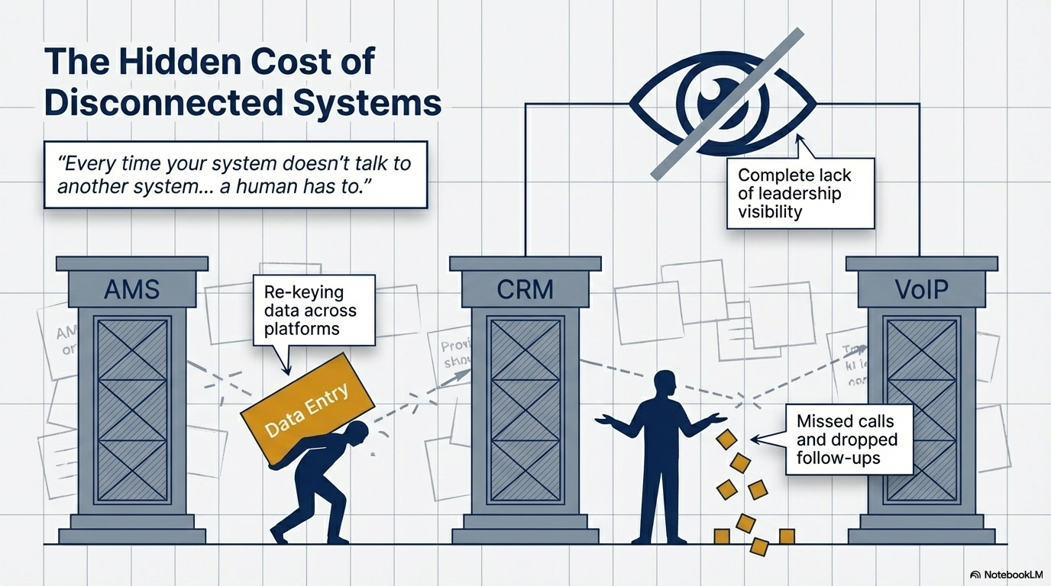

Slide 21
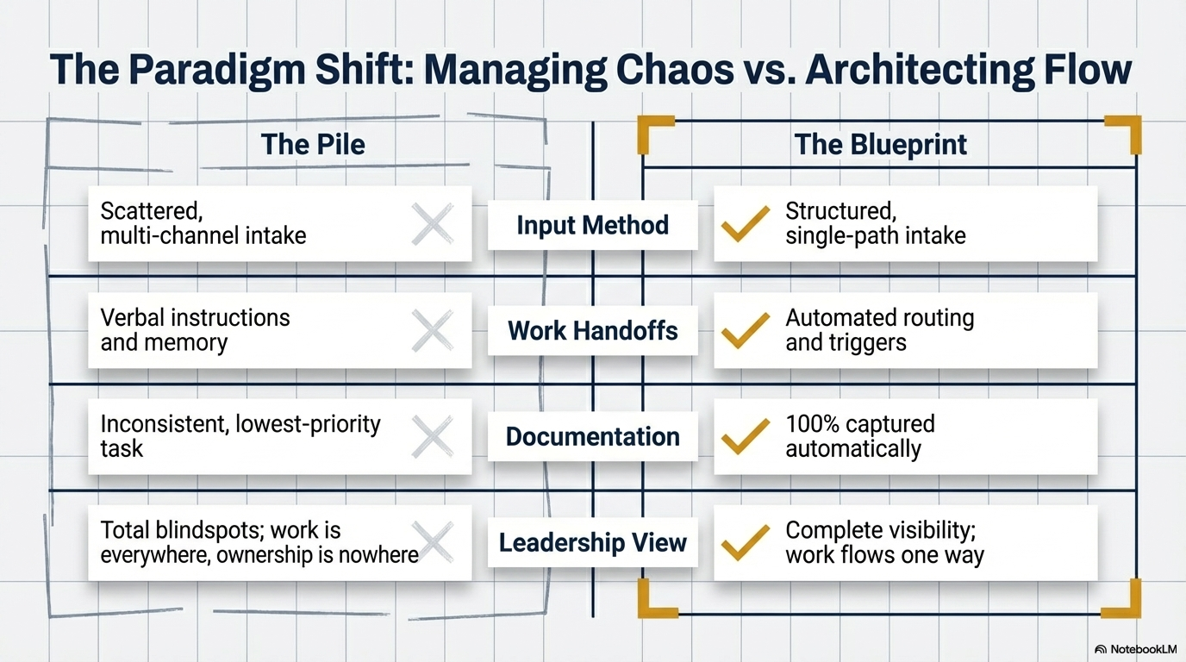

Slide 22
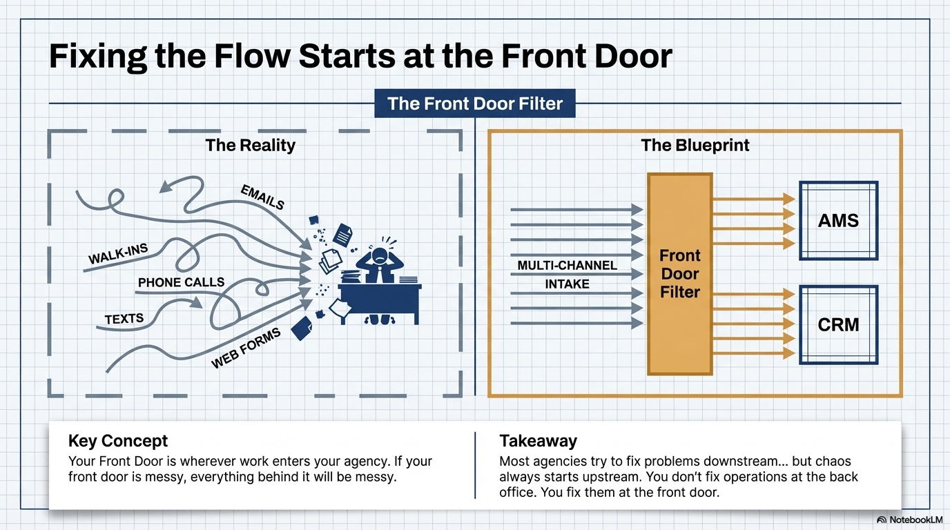

Slide 23
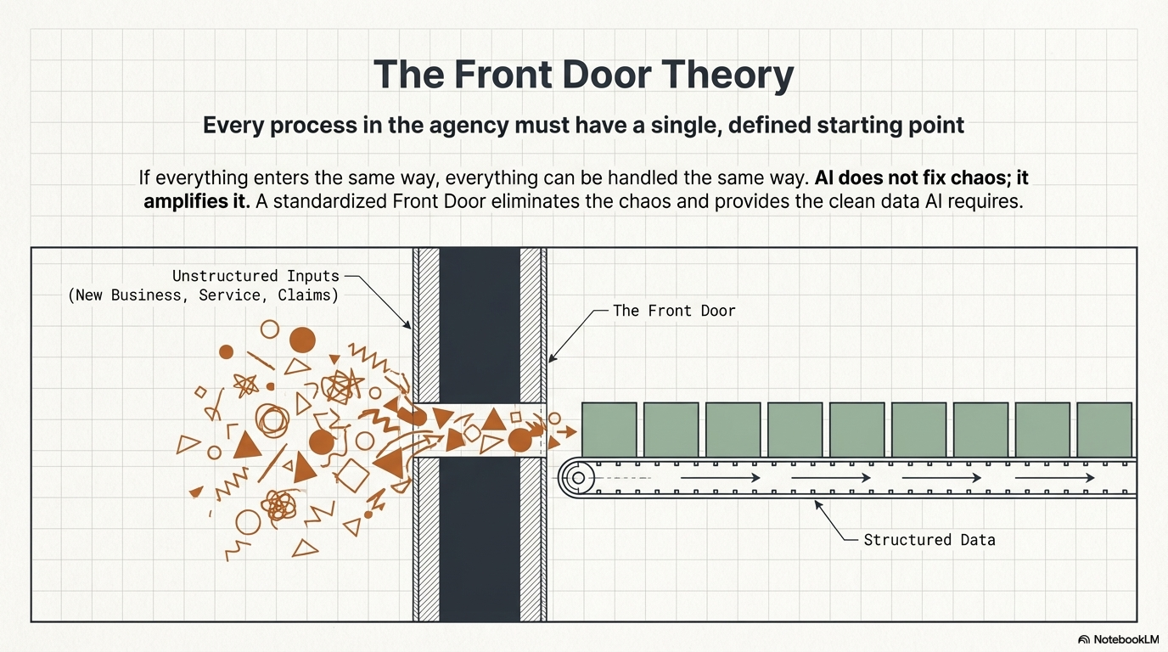

Slide 24
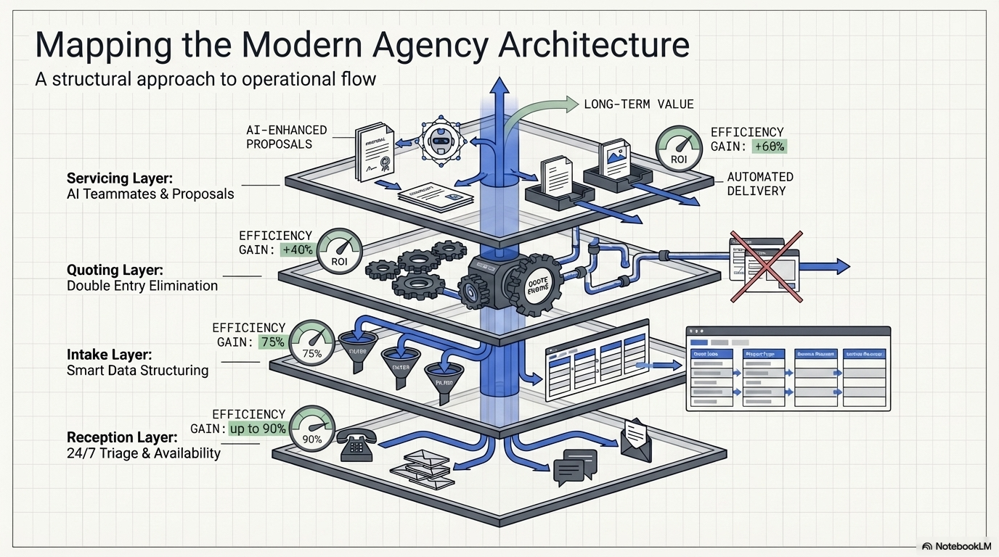

Slide 25
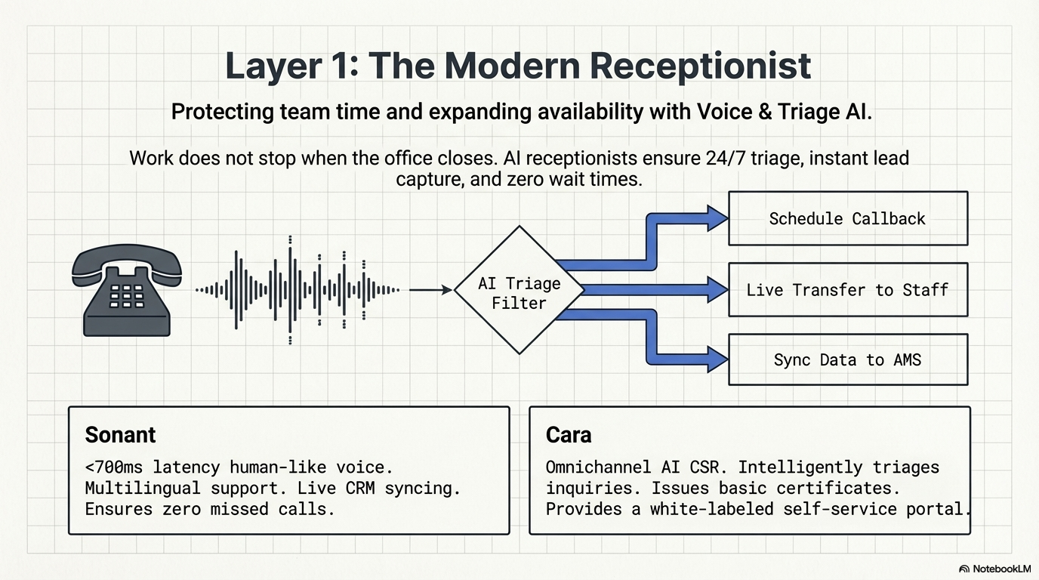

Slide 26
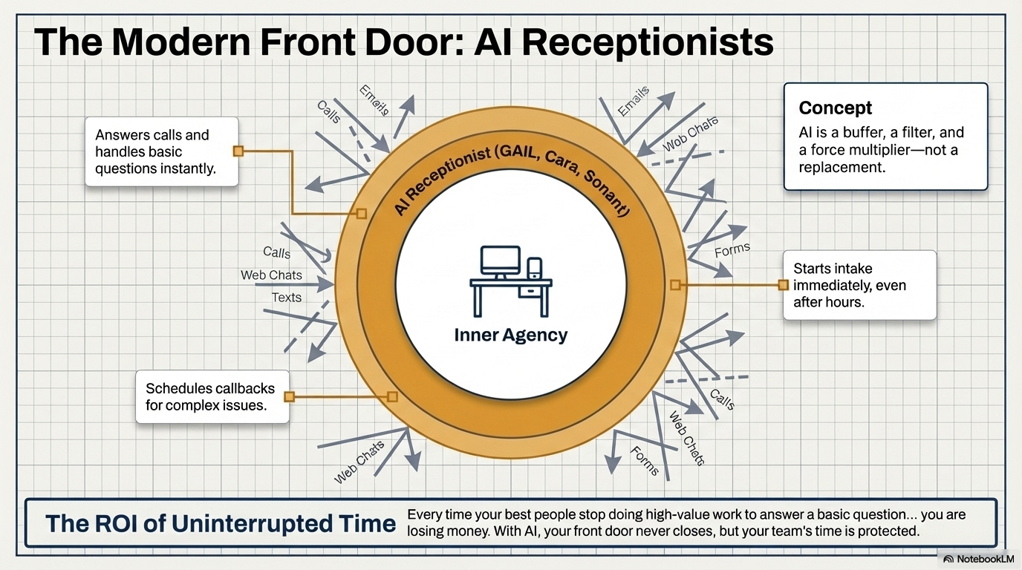

Slide 27
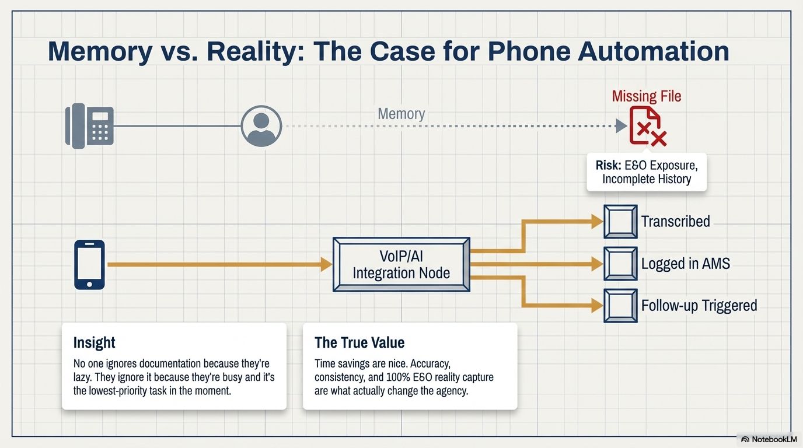

Slide 28
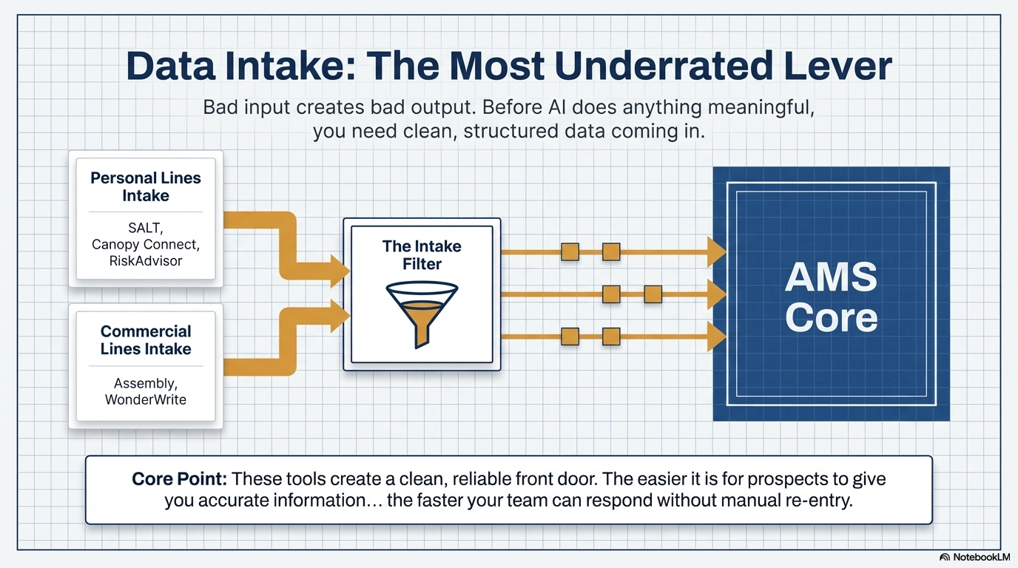
Sembley
Wunderite

Slide 29
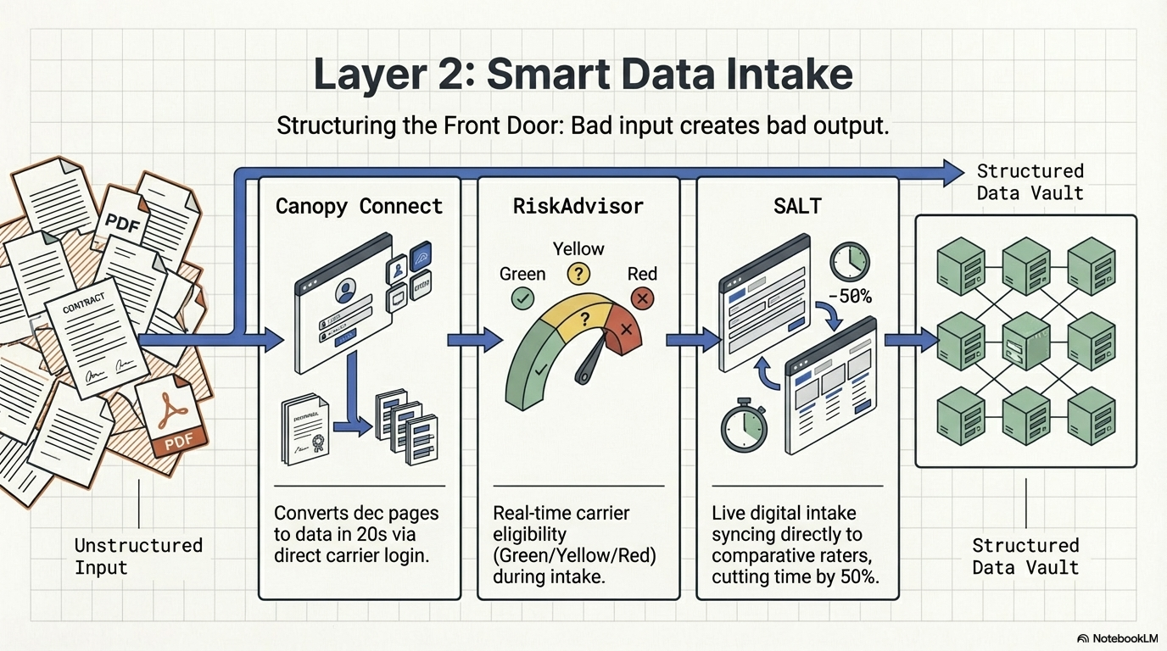

Slide 30
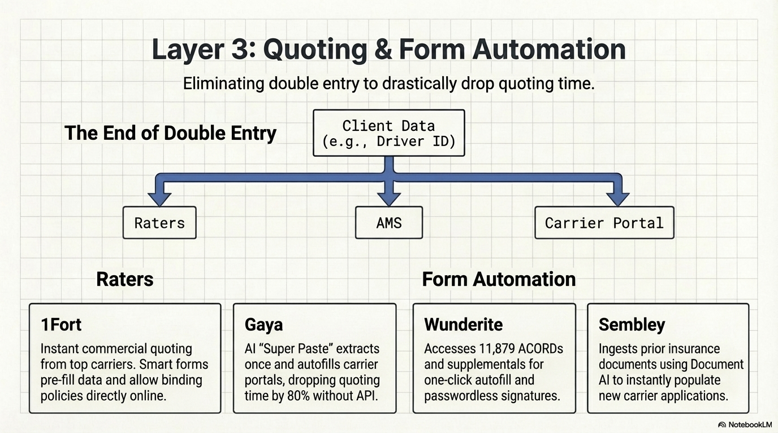

Slide 31
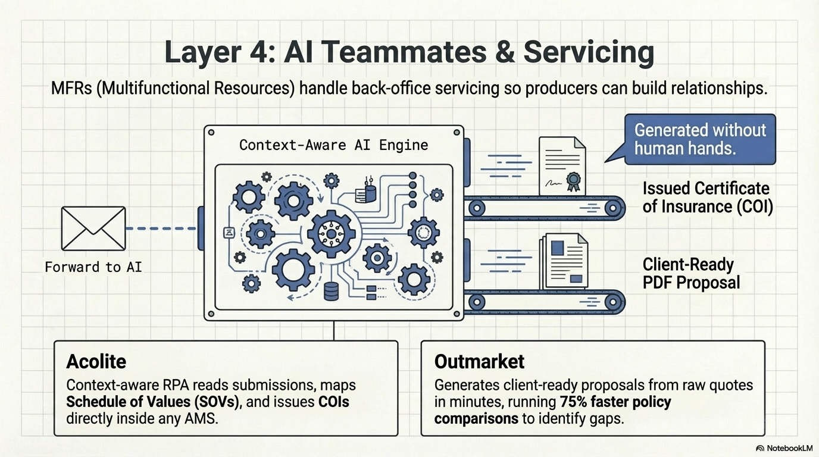

Slide 32
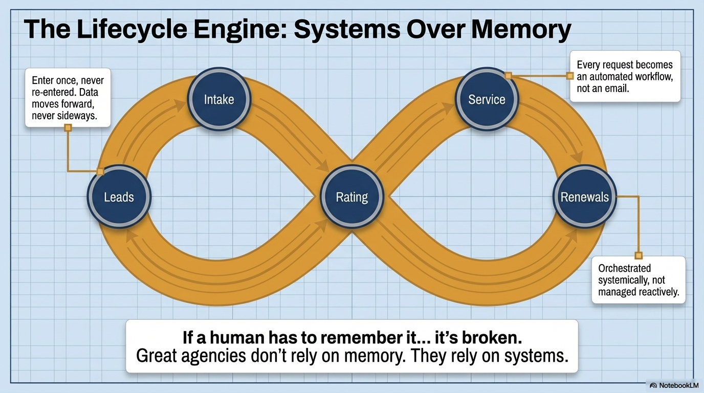

Slide 33
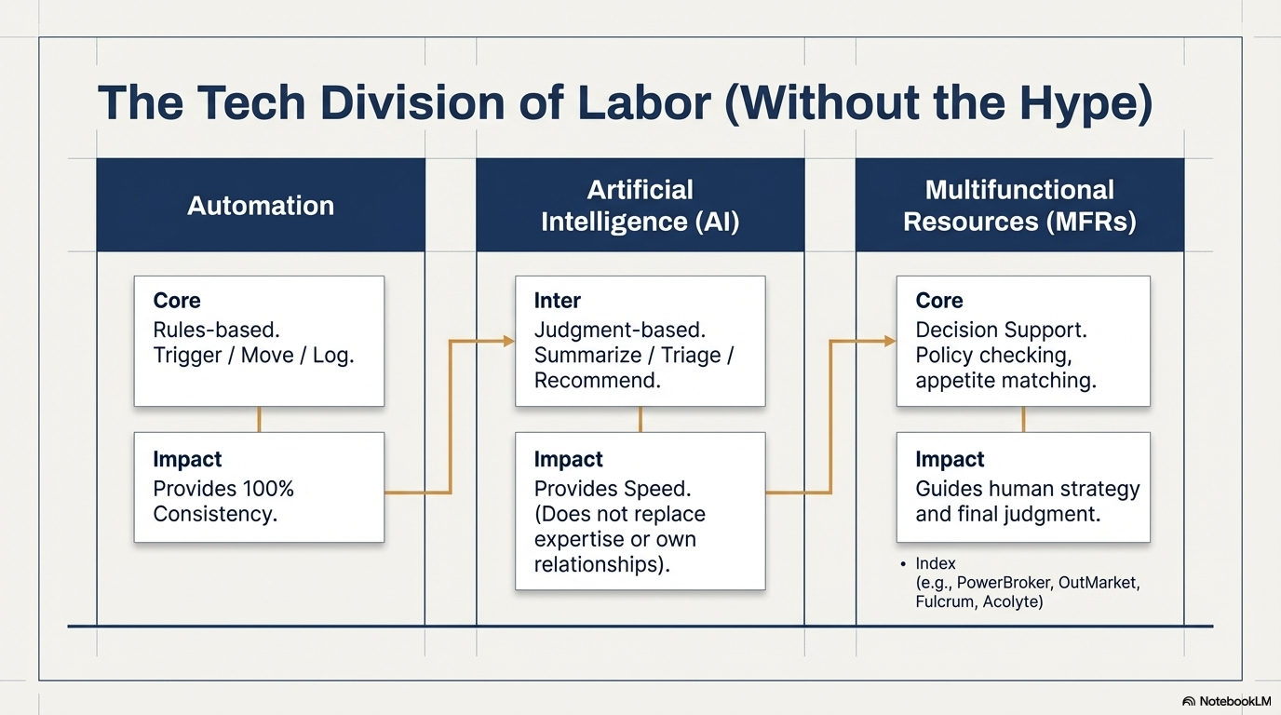

Slide 34
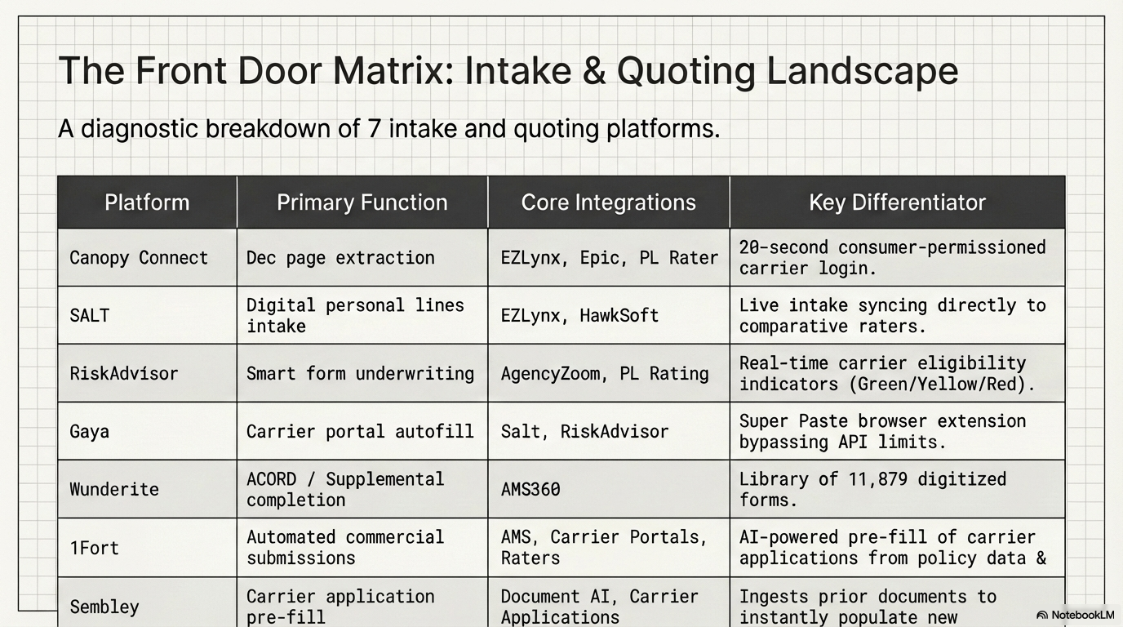

Slide 35
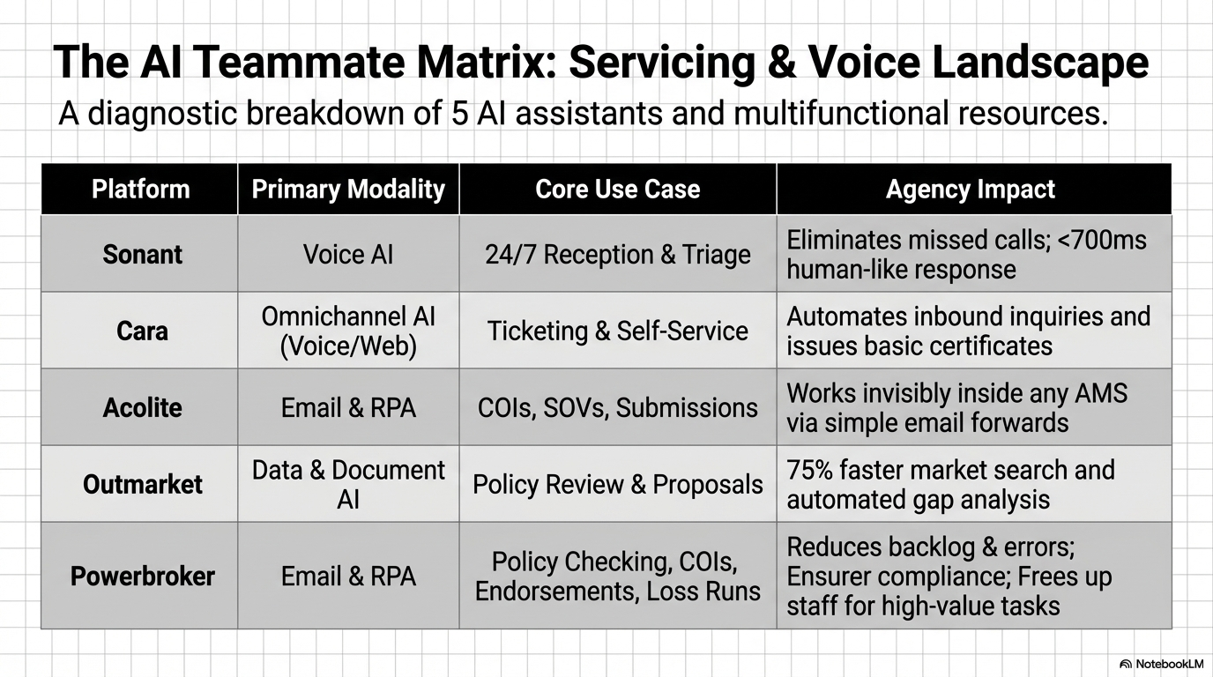

Slide 36
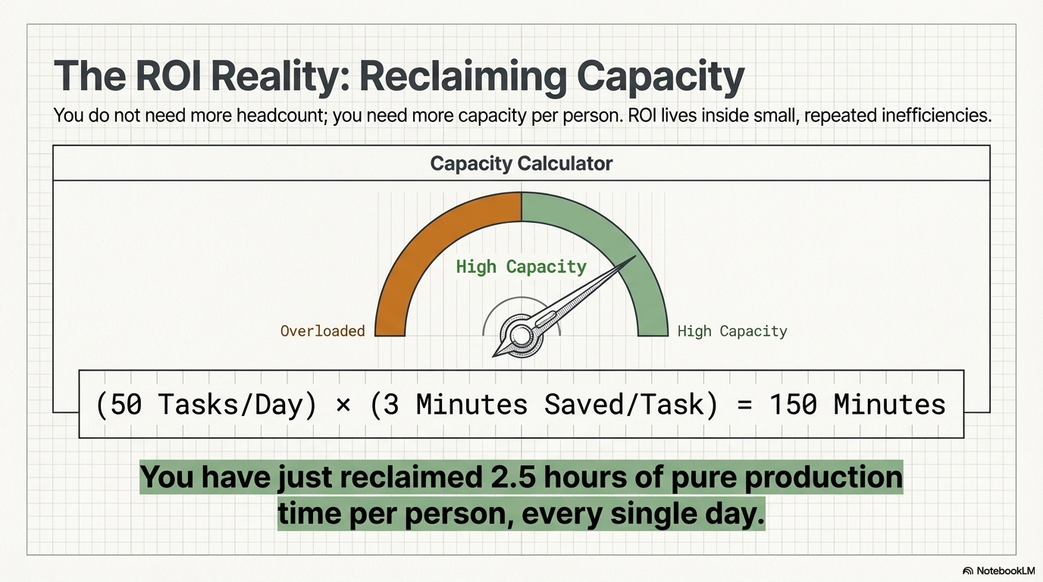

Slide 37
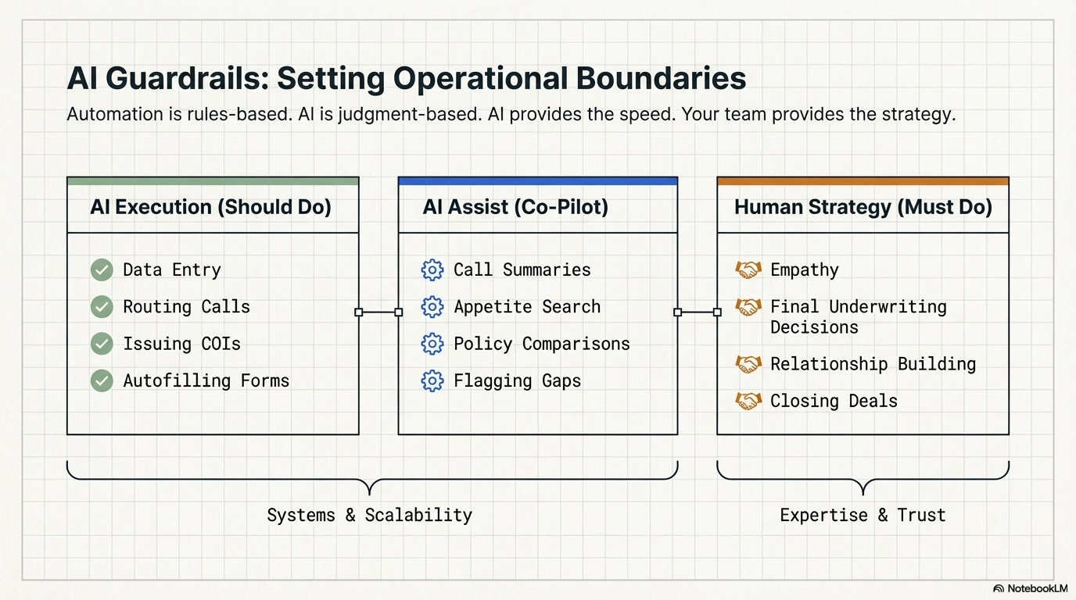

Slide 38
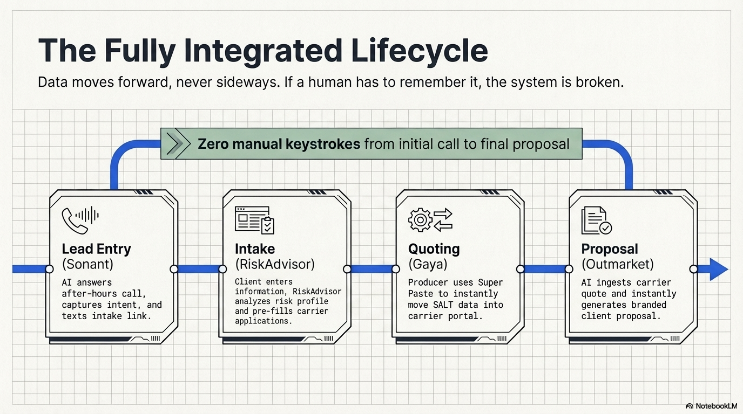

Slide 39
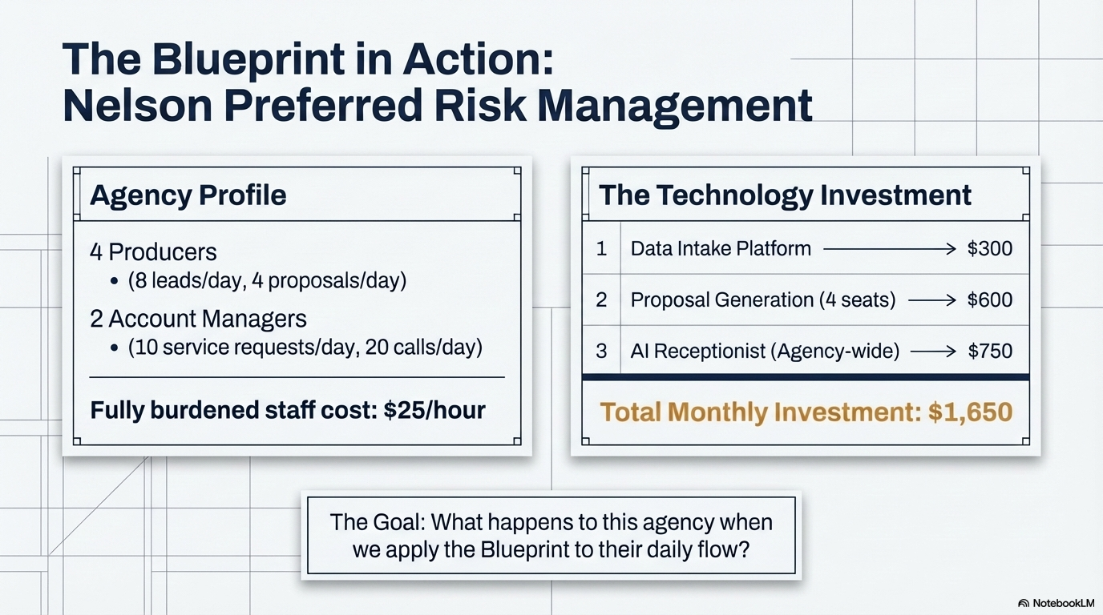

Slide 40
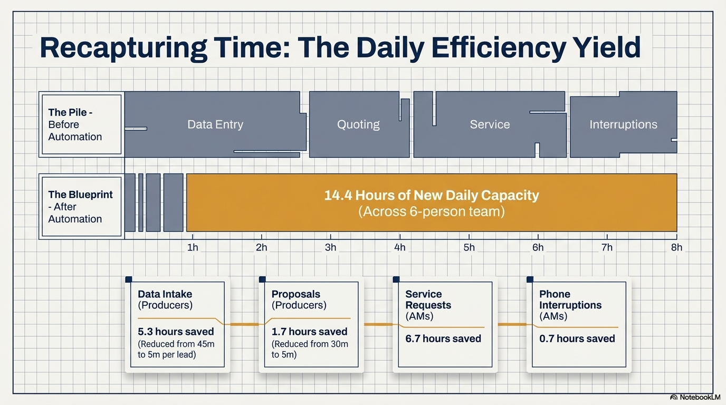

Slide 41
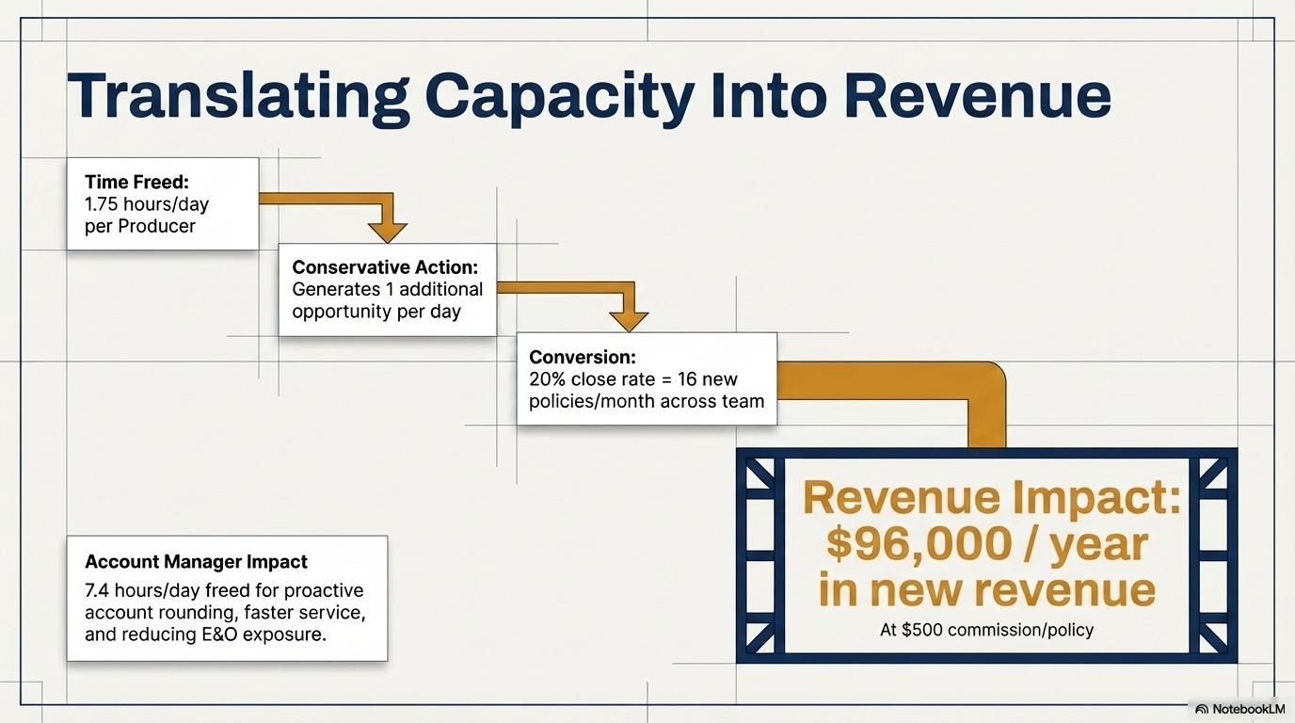

Slide 42
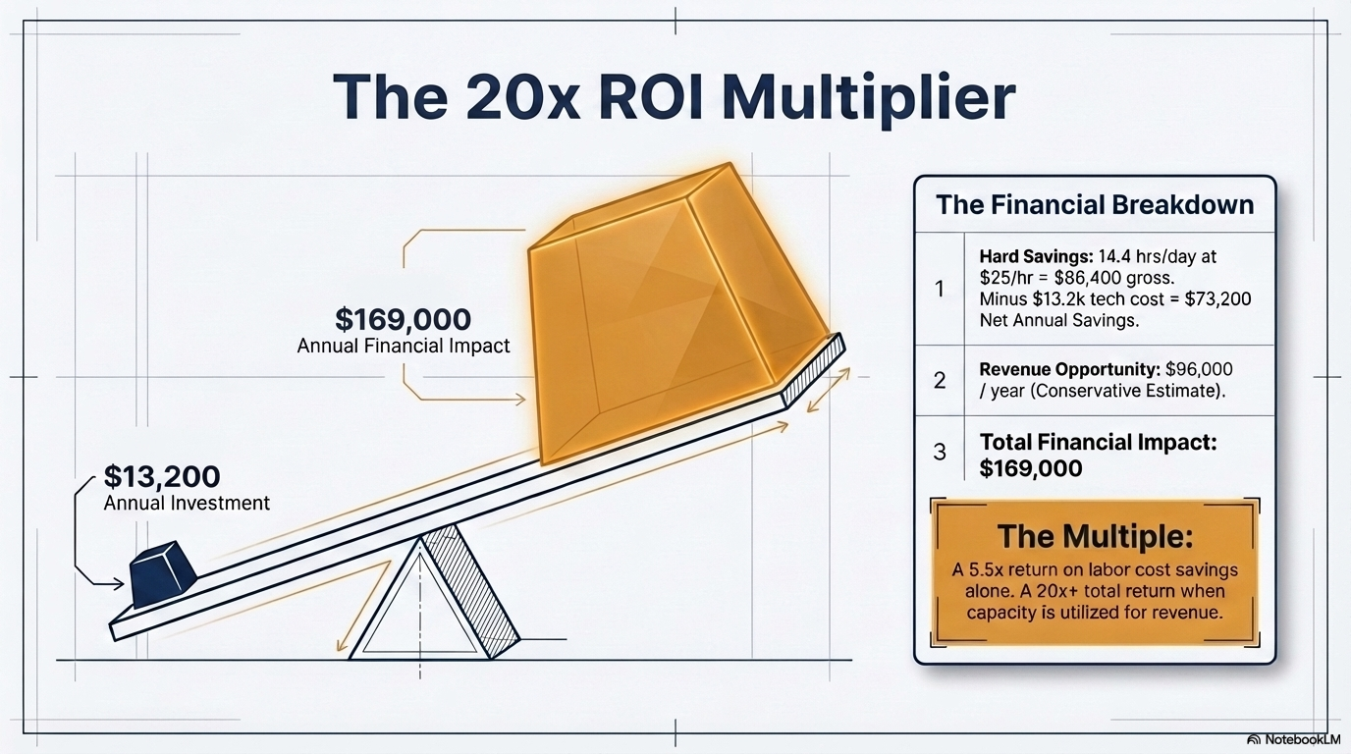

Slide 43
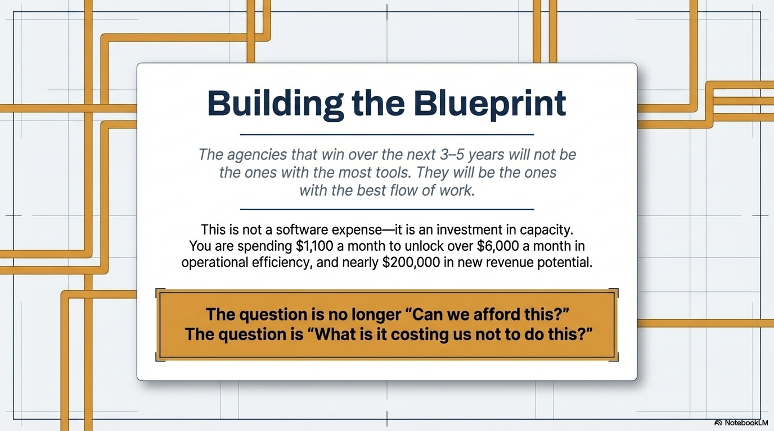

Slide 44
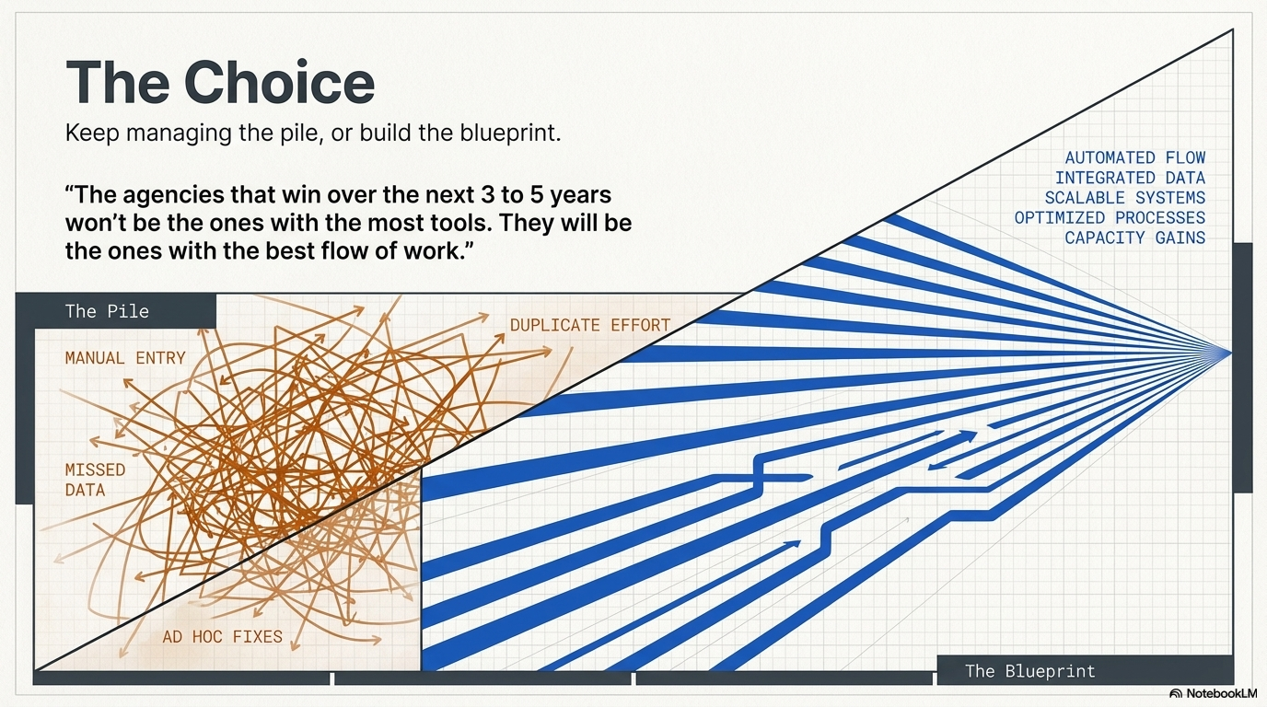


Slide 45
Questions?
Casey Nelson
casey@catalyit.com
www.linkedin.com/in/caseynelson-bolt/

